Slide 1
Calculus of Variations Approach to Social Distancing

Slide 2
## Loading required package: ggplot2
## Loading required package: viridis
## Loading required package: viridisLite
## Loading required package: ggthemes
## Loading required package: rootSolve
## Loading required package: latex2exp

Slide 3
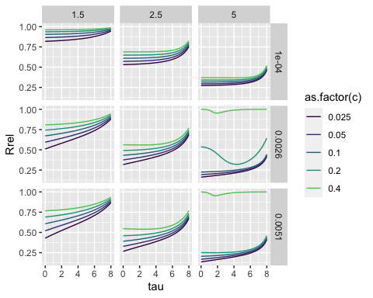

Slide 4
f1.5 <- function(x,R0){exp(-1.5*(1-x))-x} f2.5 <- function(x,R0){exp(-2.5*(1-x))-x} f5 <- function(x,R0){exp(-5*(1-x))-x}
Sinf1.5 <- multiroot.1D(f=f1.5,start = .5,nspec= 1)[["root"]] Sinf2.5 <- multiroot.1D(f=f2.5,start = .5,nspec= 1)[["root"]] Sinf5 <- multiroot.1D(f=f5,start = .5,nspec= 1)[["root"]] S1.5max <- 1/1.5 S2.5max <- 2.5 S5max <- 5 d$months <- d$tau/2 d$tFinal <- factor(d$tFinal,levels = c(8,16, 32, 64, 128))
aux$c[aux$c == 0.025] <- "Suppression" aux$c[aux$c == 0.4] <- "Mitigation (Herd Immunity)" require(tidyr)
## Loading required package: tidyr
aux$c[aux$c == 0.025] <- "Suppression" aux$c[aux$c == 0.4] <- "Mitigation (Herd Immunity)" x <- seq(0.01,1,.01) y <- -log(x)+x-1 p <- as.data.frame(cbind(x,y)) g <- ggplot(p,aes(x=x,y=y))+geom_line()+theme_bw()+scale_x_continuous(breaks = c(0,.2,.4,.6,.8,1),labels = c(0, "0.2","0.4","0.6","0.8","1"))+xlab("RD")+ylab("g(x)")+xlab("x")+scale_y_continuous(breaks= c(0,1,2,3),labels = c(0, "1", "2","3")) g

Slide 5
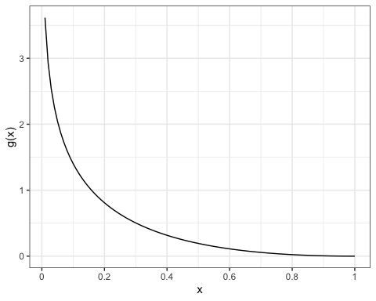

Slide 6
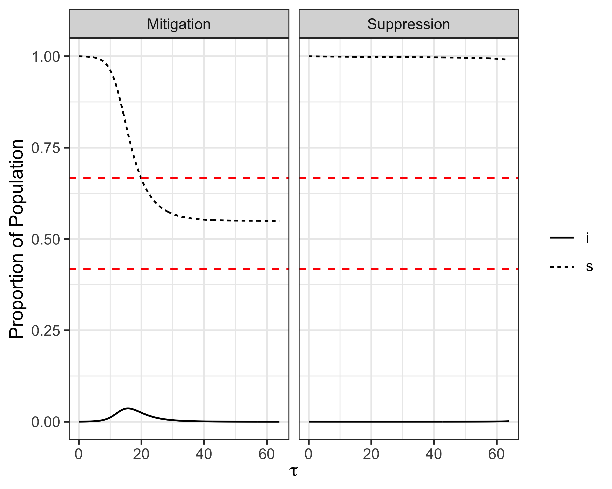

Slide 7
## quartz_off_screen ## 2

Slide 8
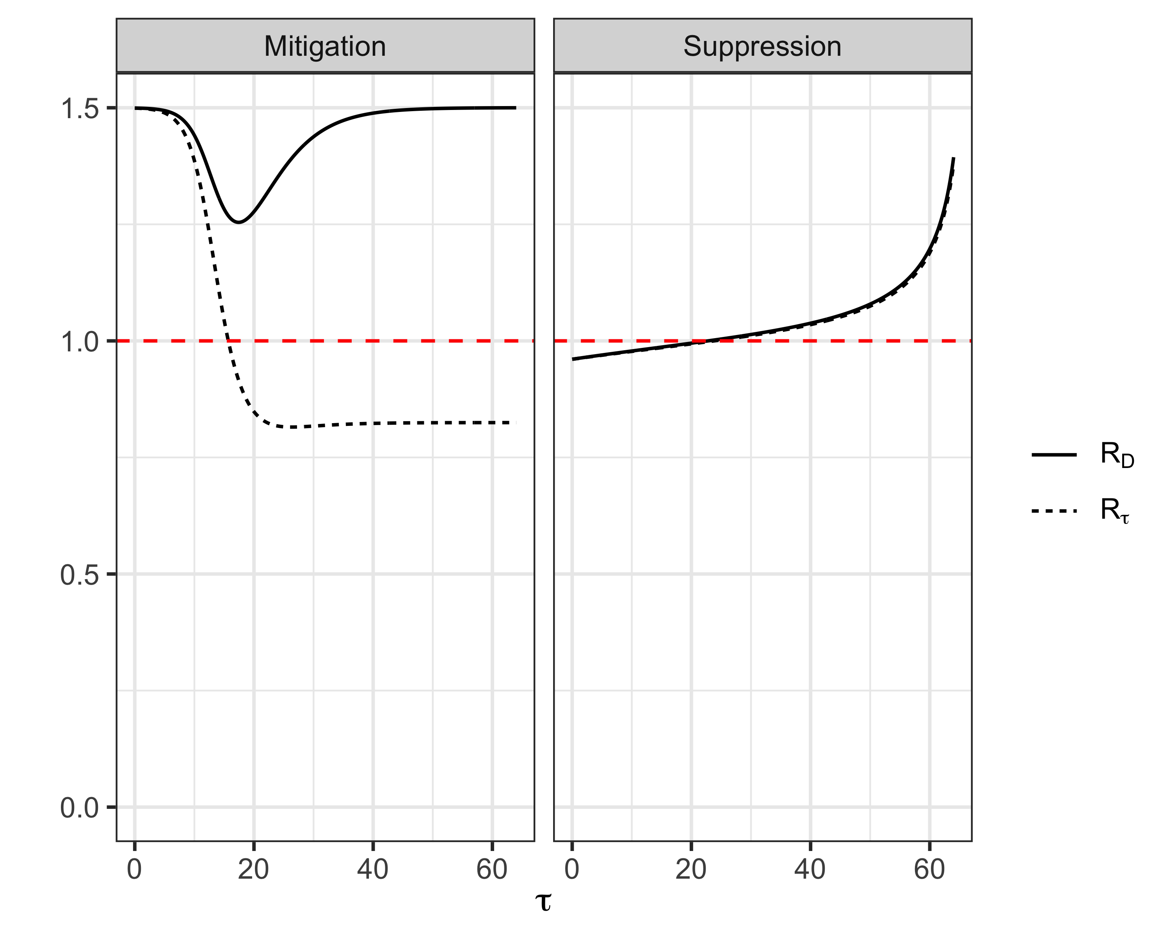

Slide 9
## quartz_off_screen ## 2

Slide 10
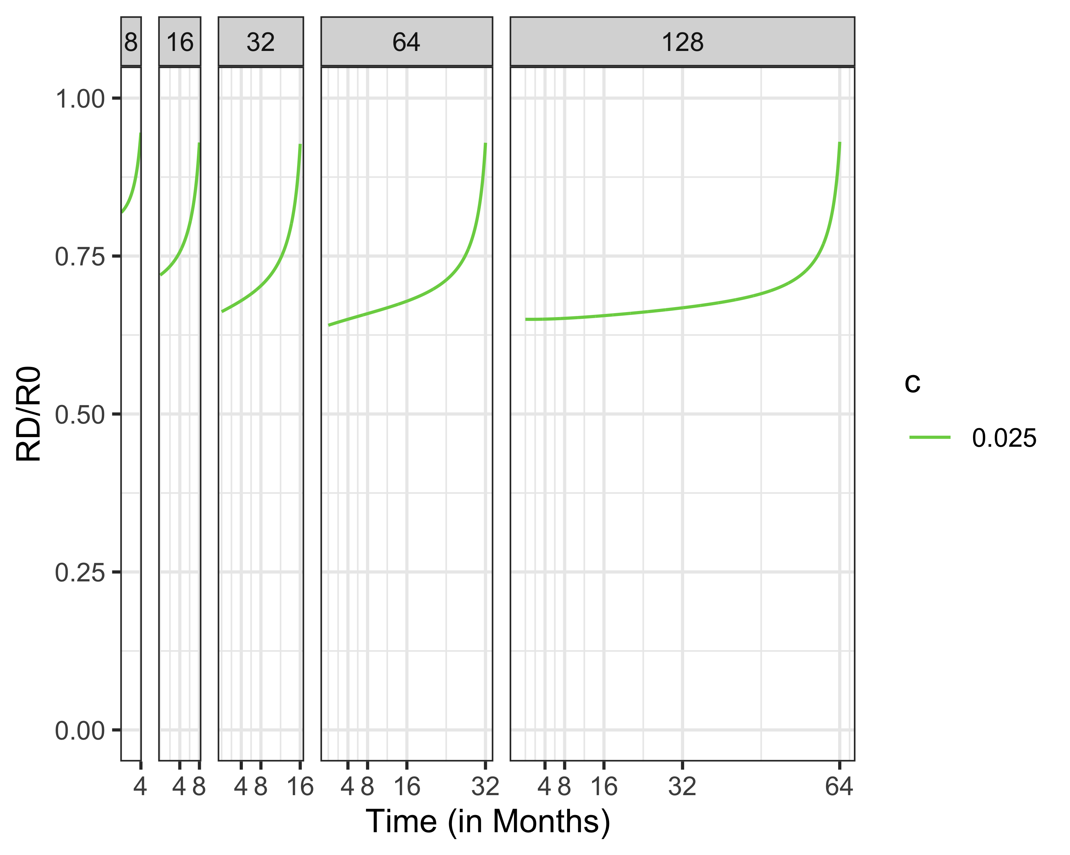

Slide 11
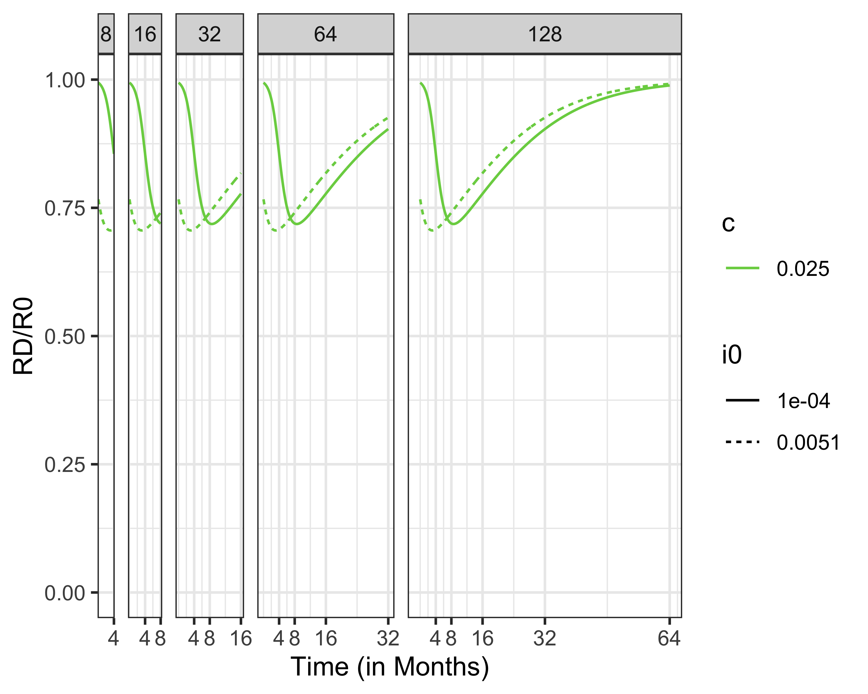

Slide 12
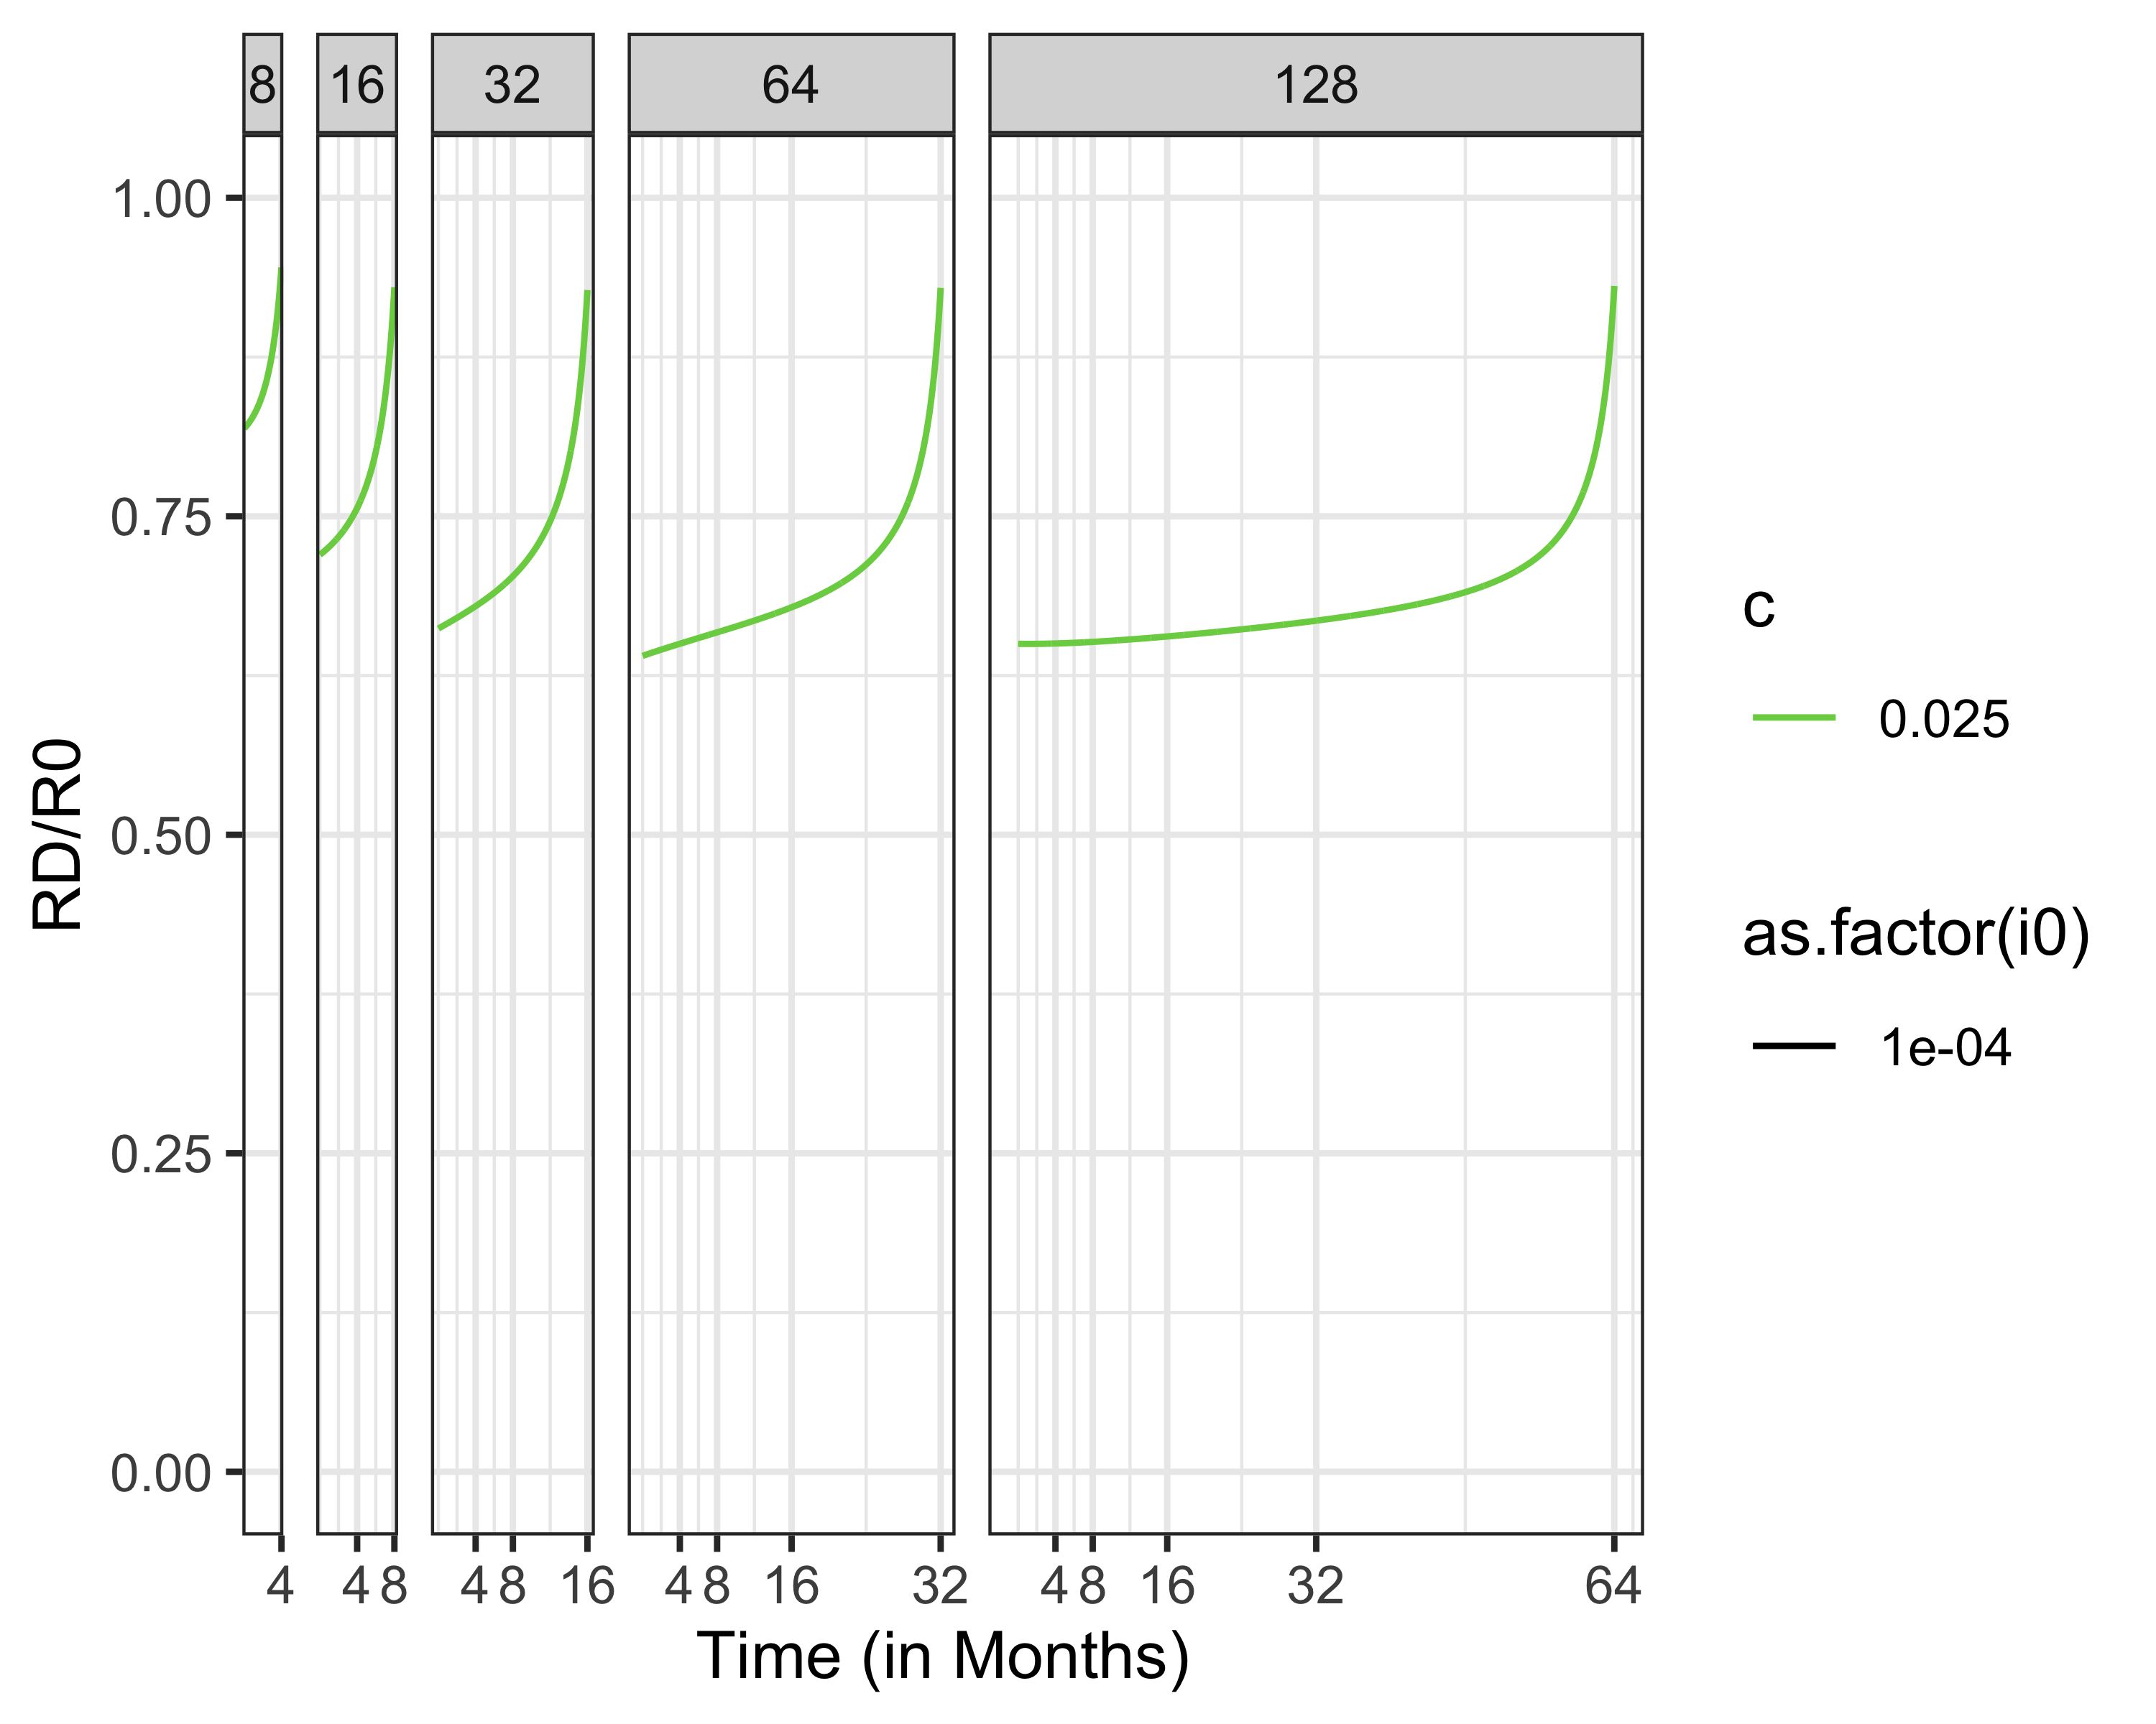
R_D/R_0, Social Distancing Over Time

Slide 13
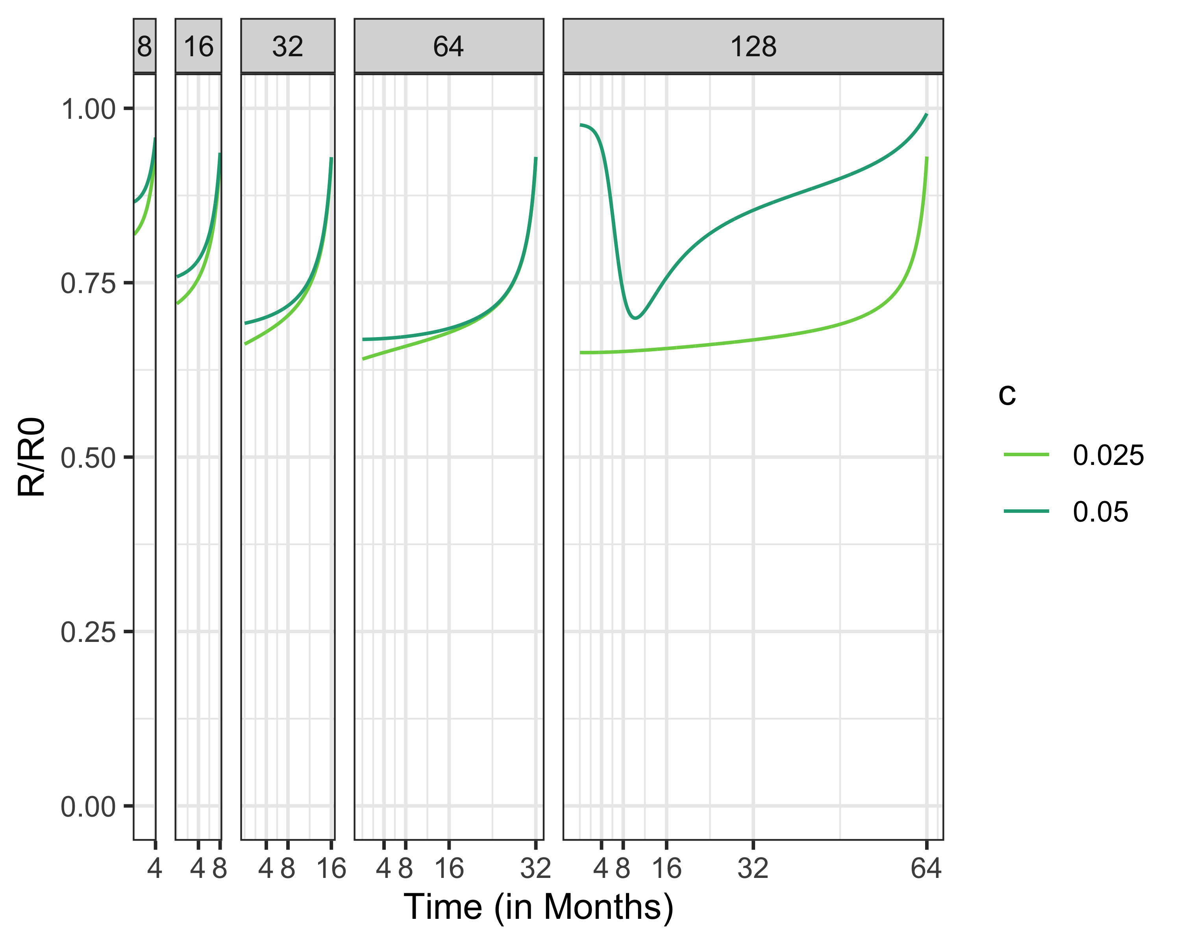

Slide 14
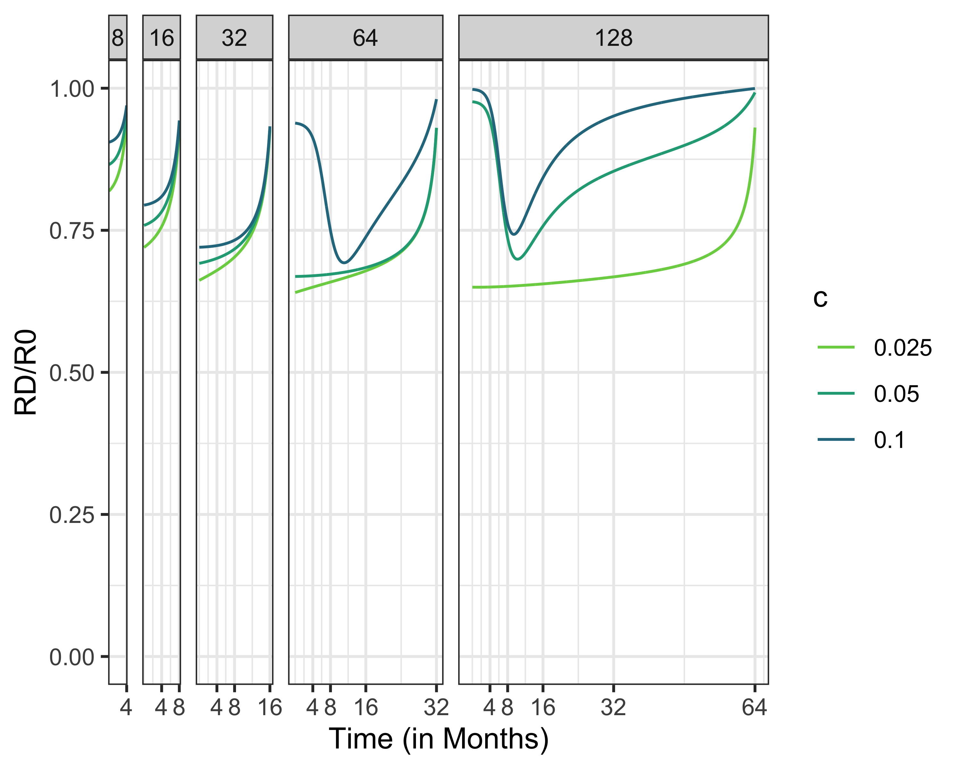

Slide 15
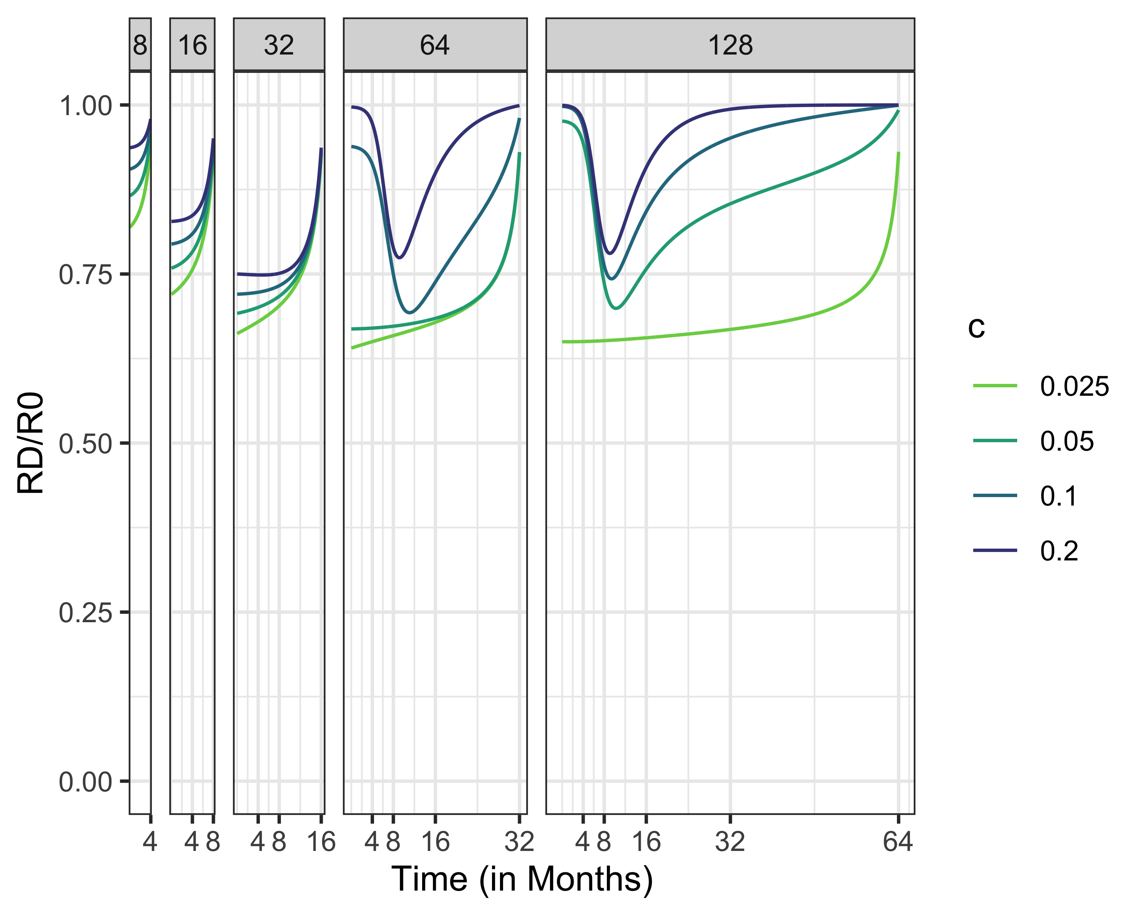

Slide 16
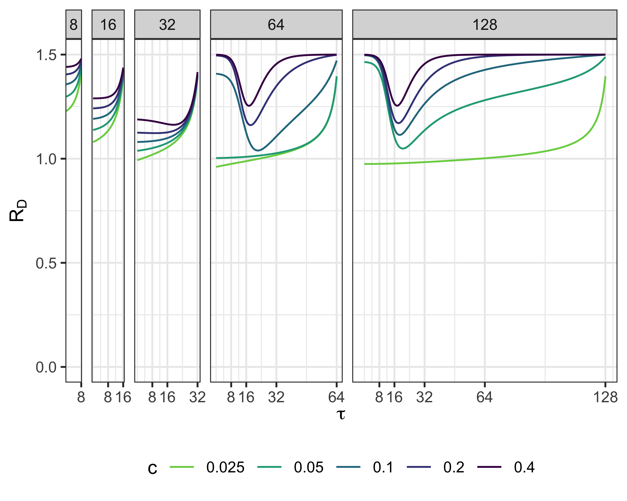
RD, R0 = 1.5

Slide 17
## quartz_off_screen ## 2

Slide 18
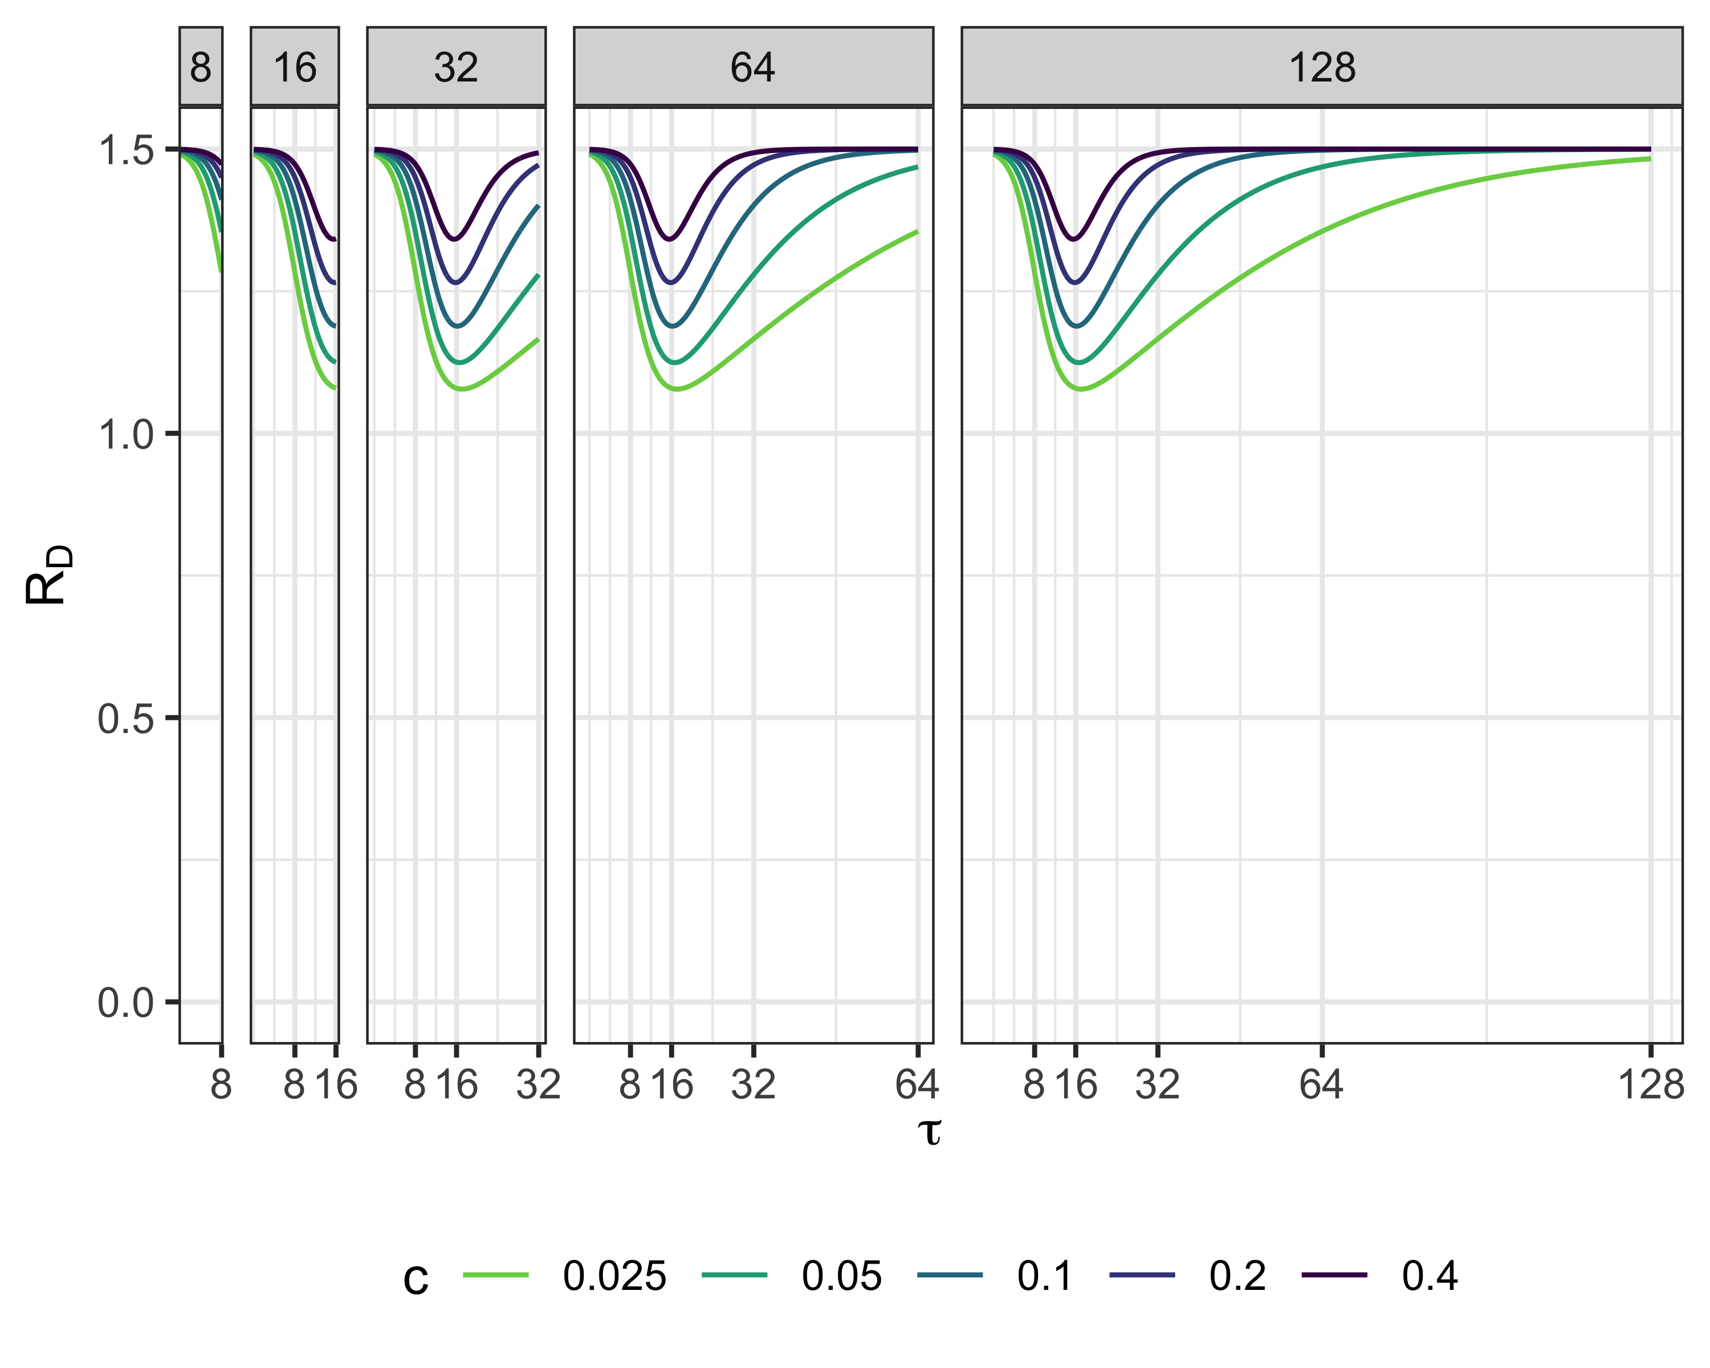

Slide 19
## quartz_off_screen ## 2

Slide 20
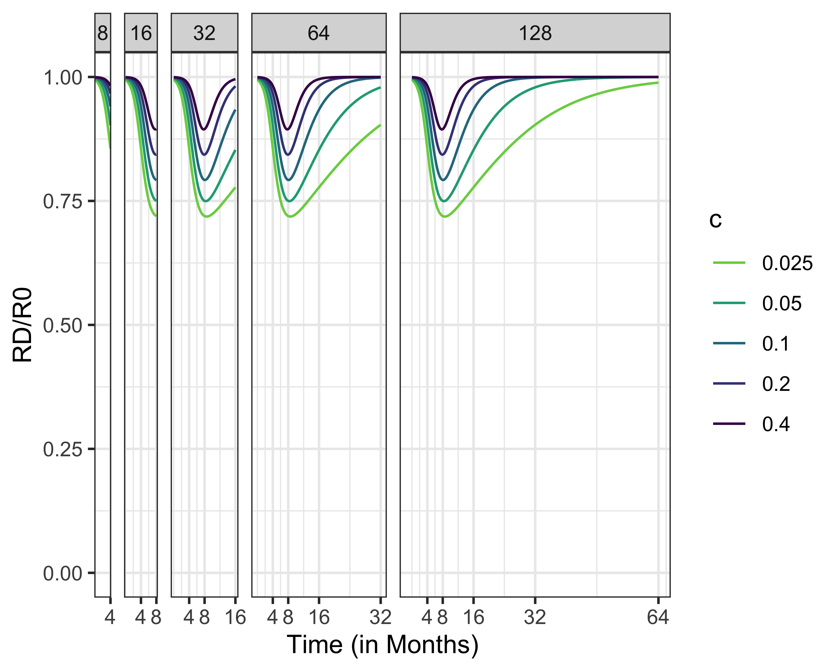

Slide 21
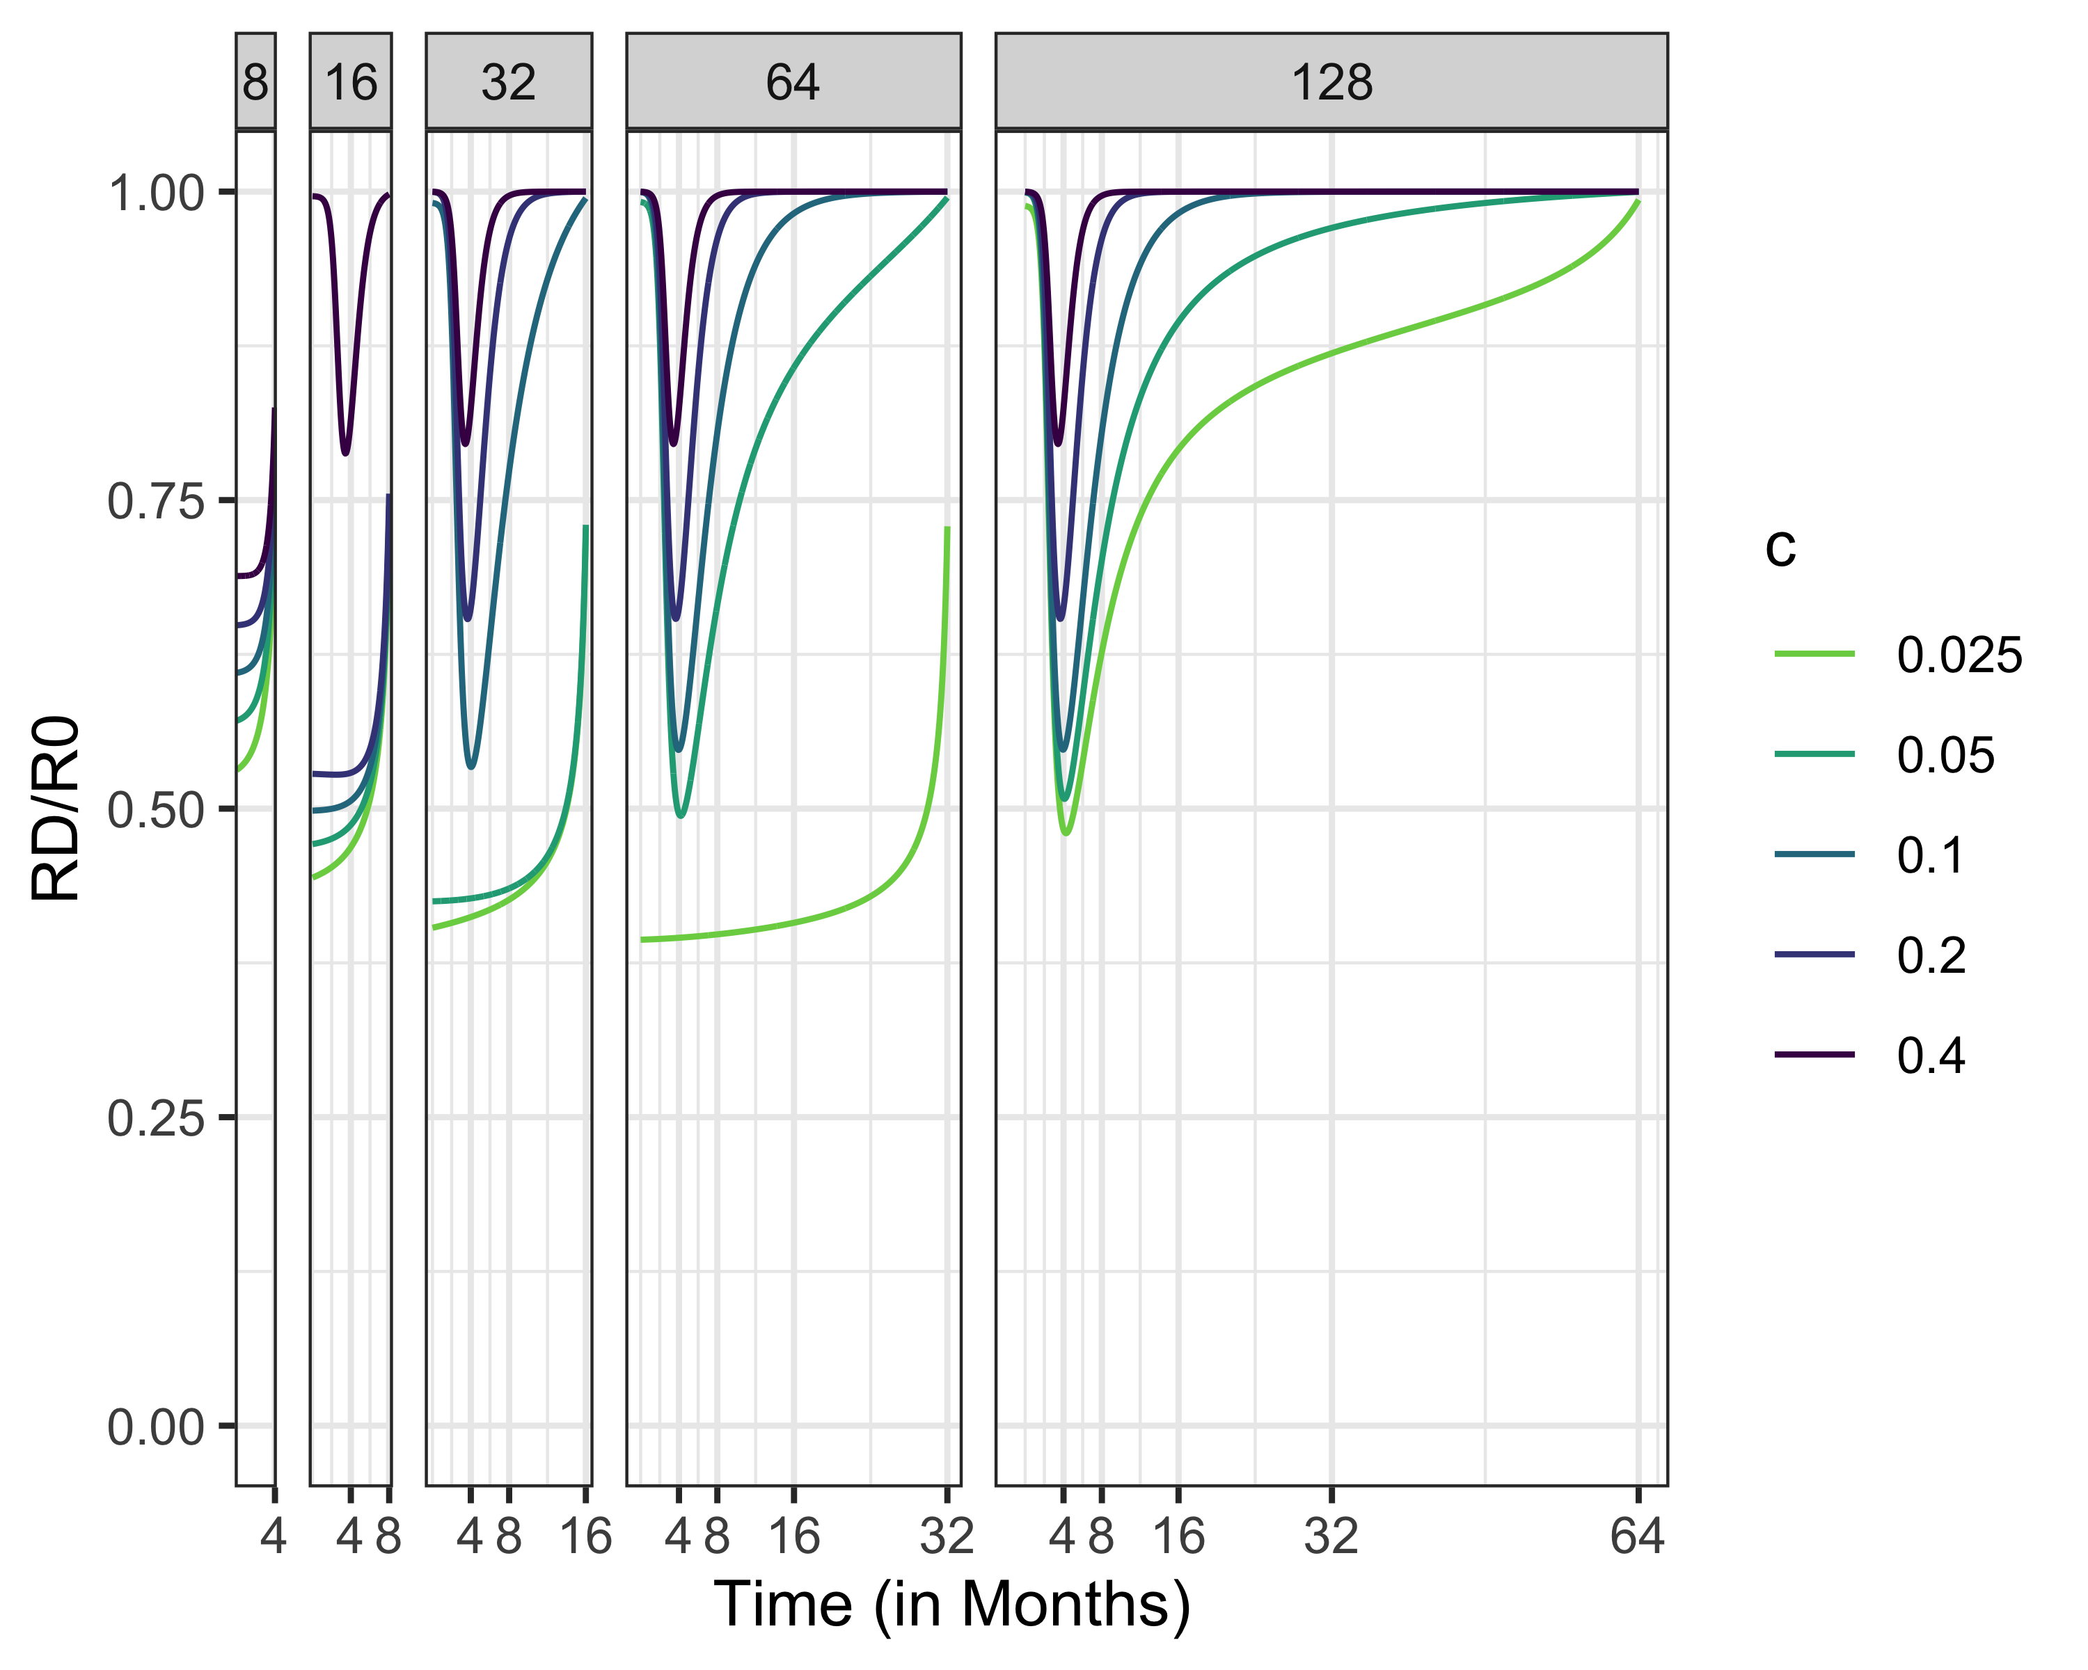

Slide 22
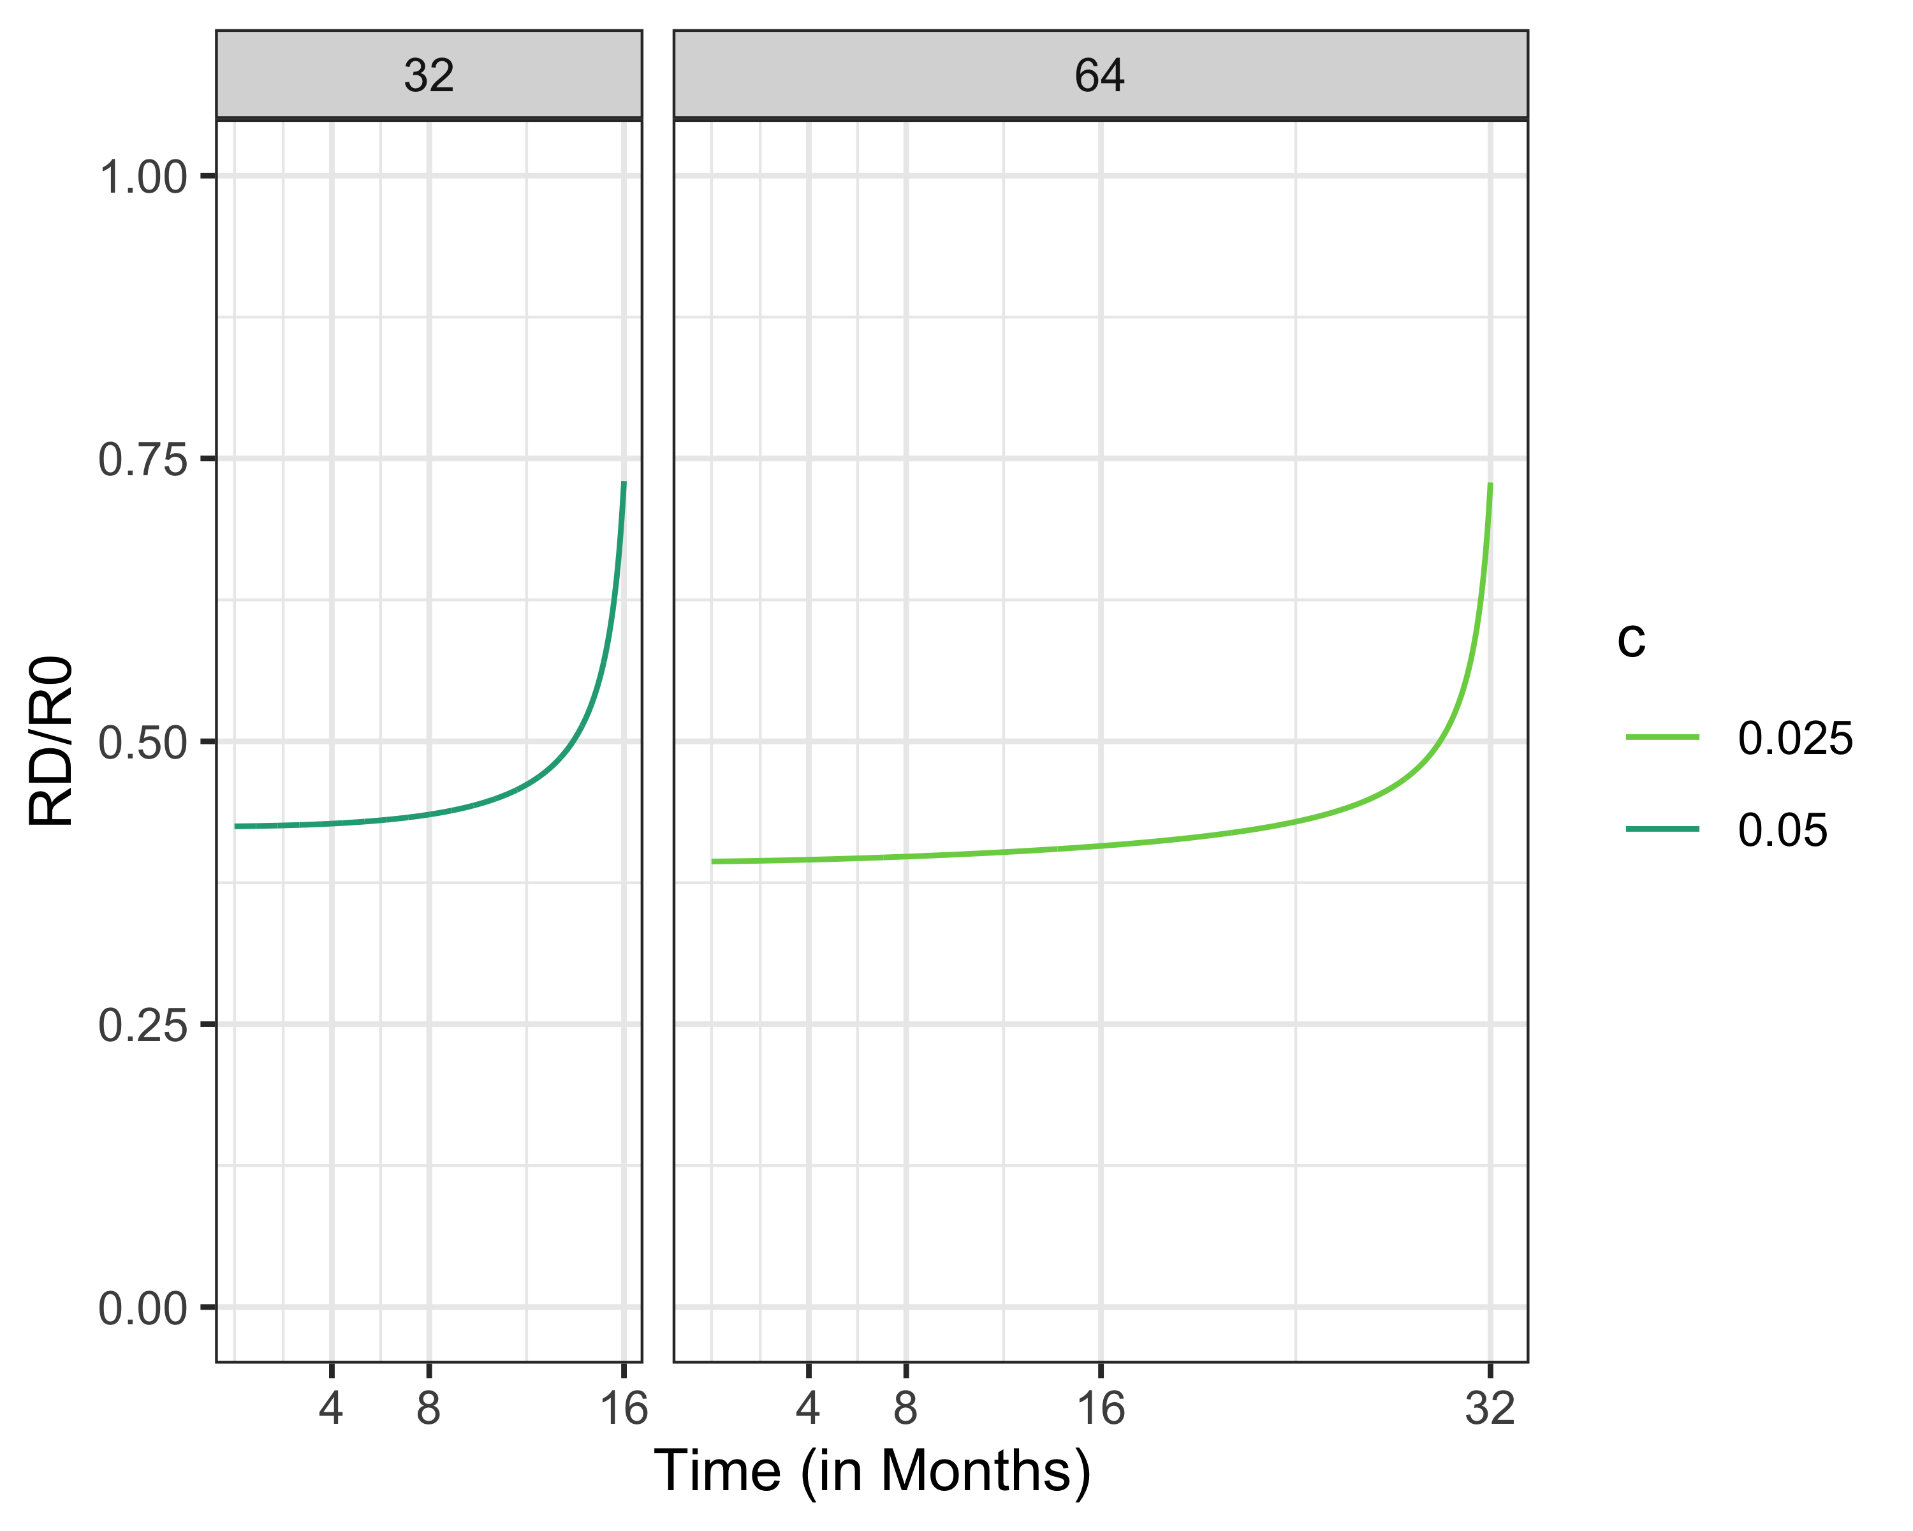

Slide 23
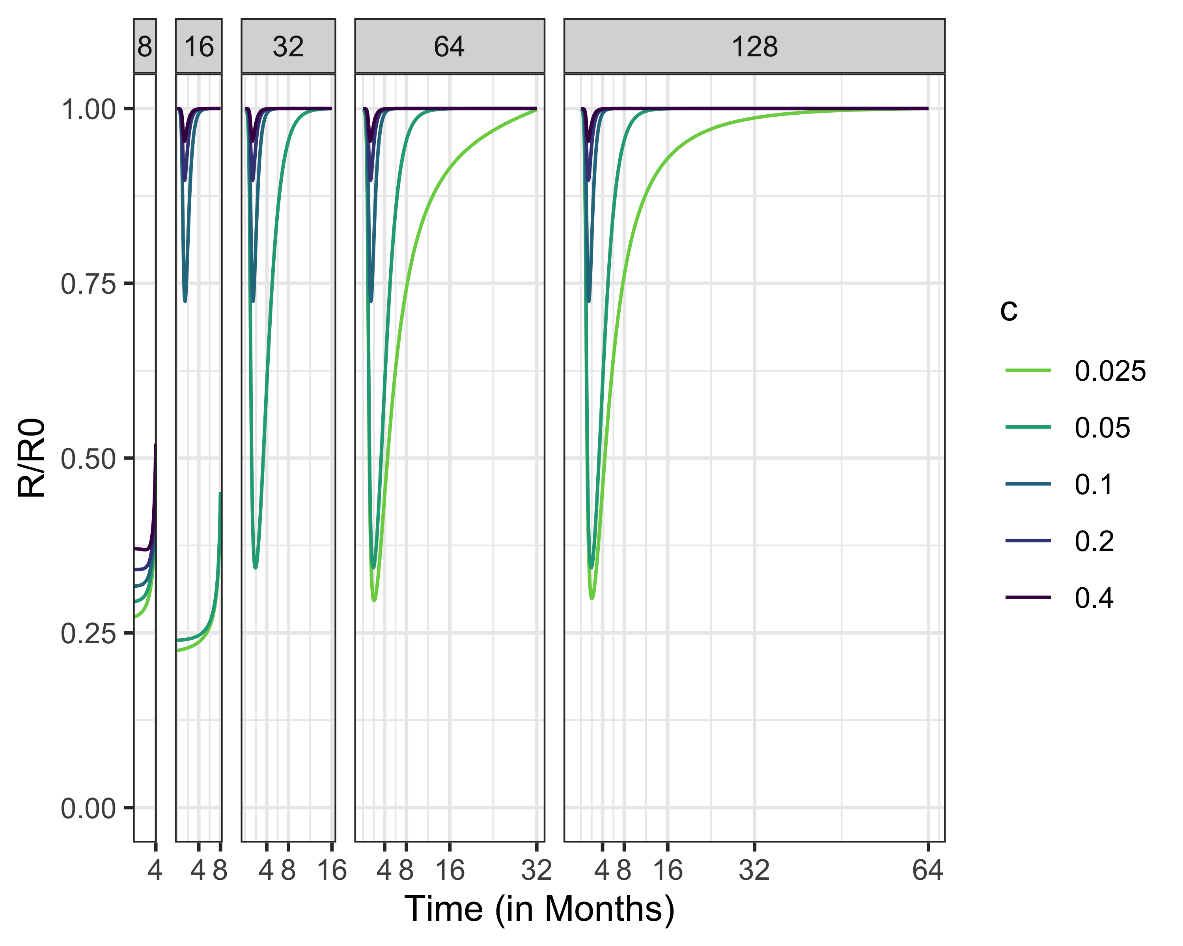
RD, R0 = 5

Slide 24
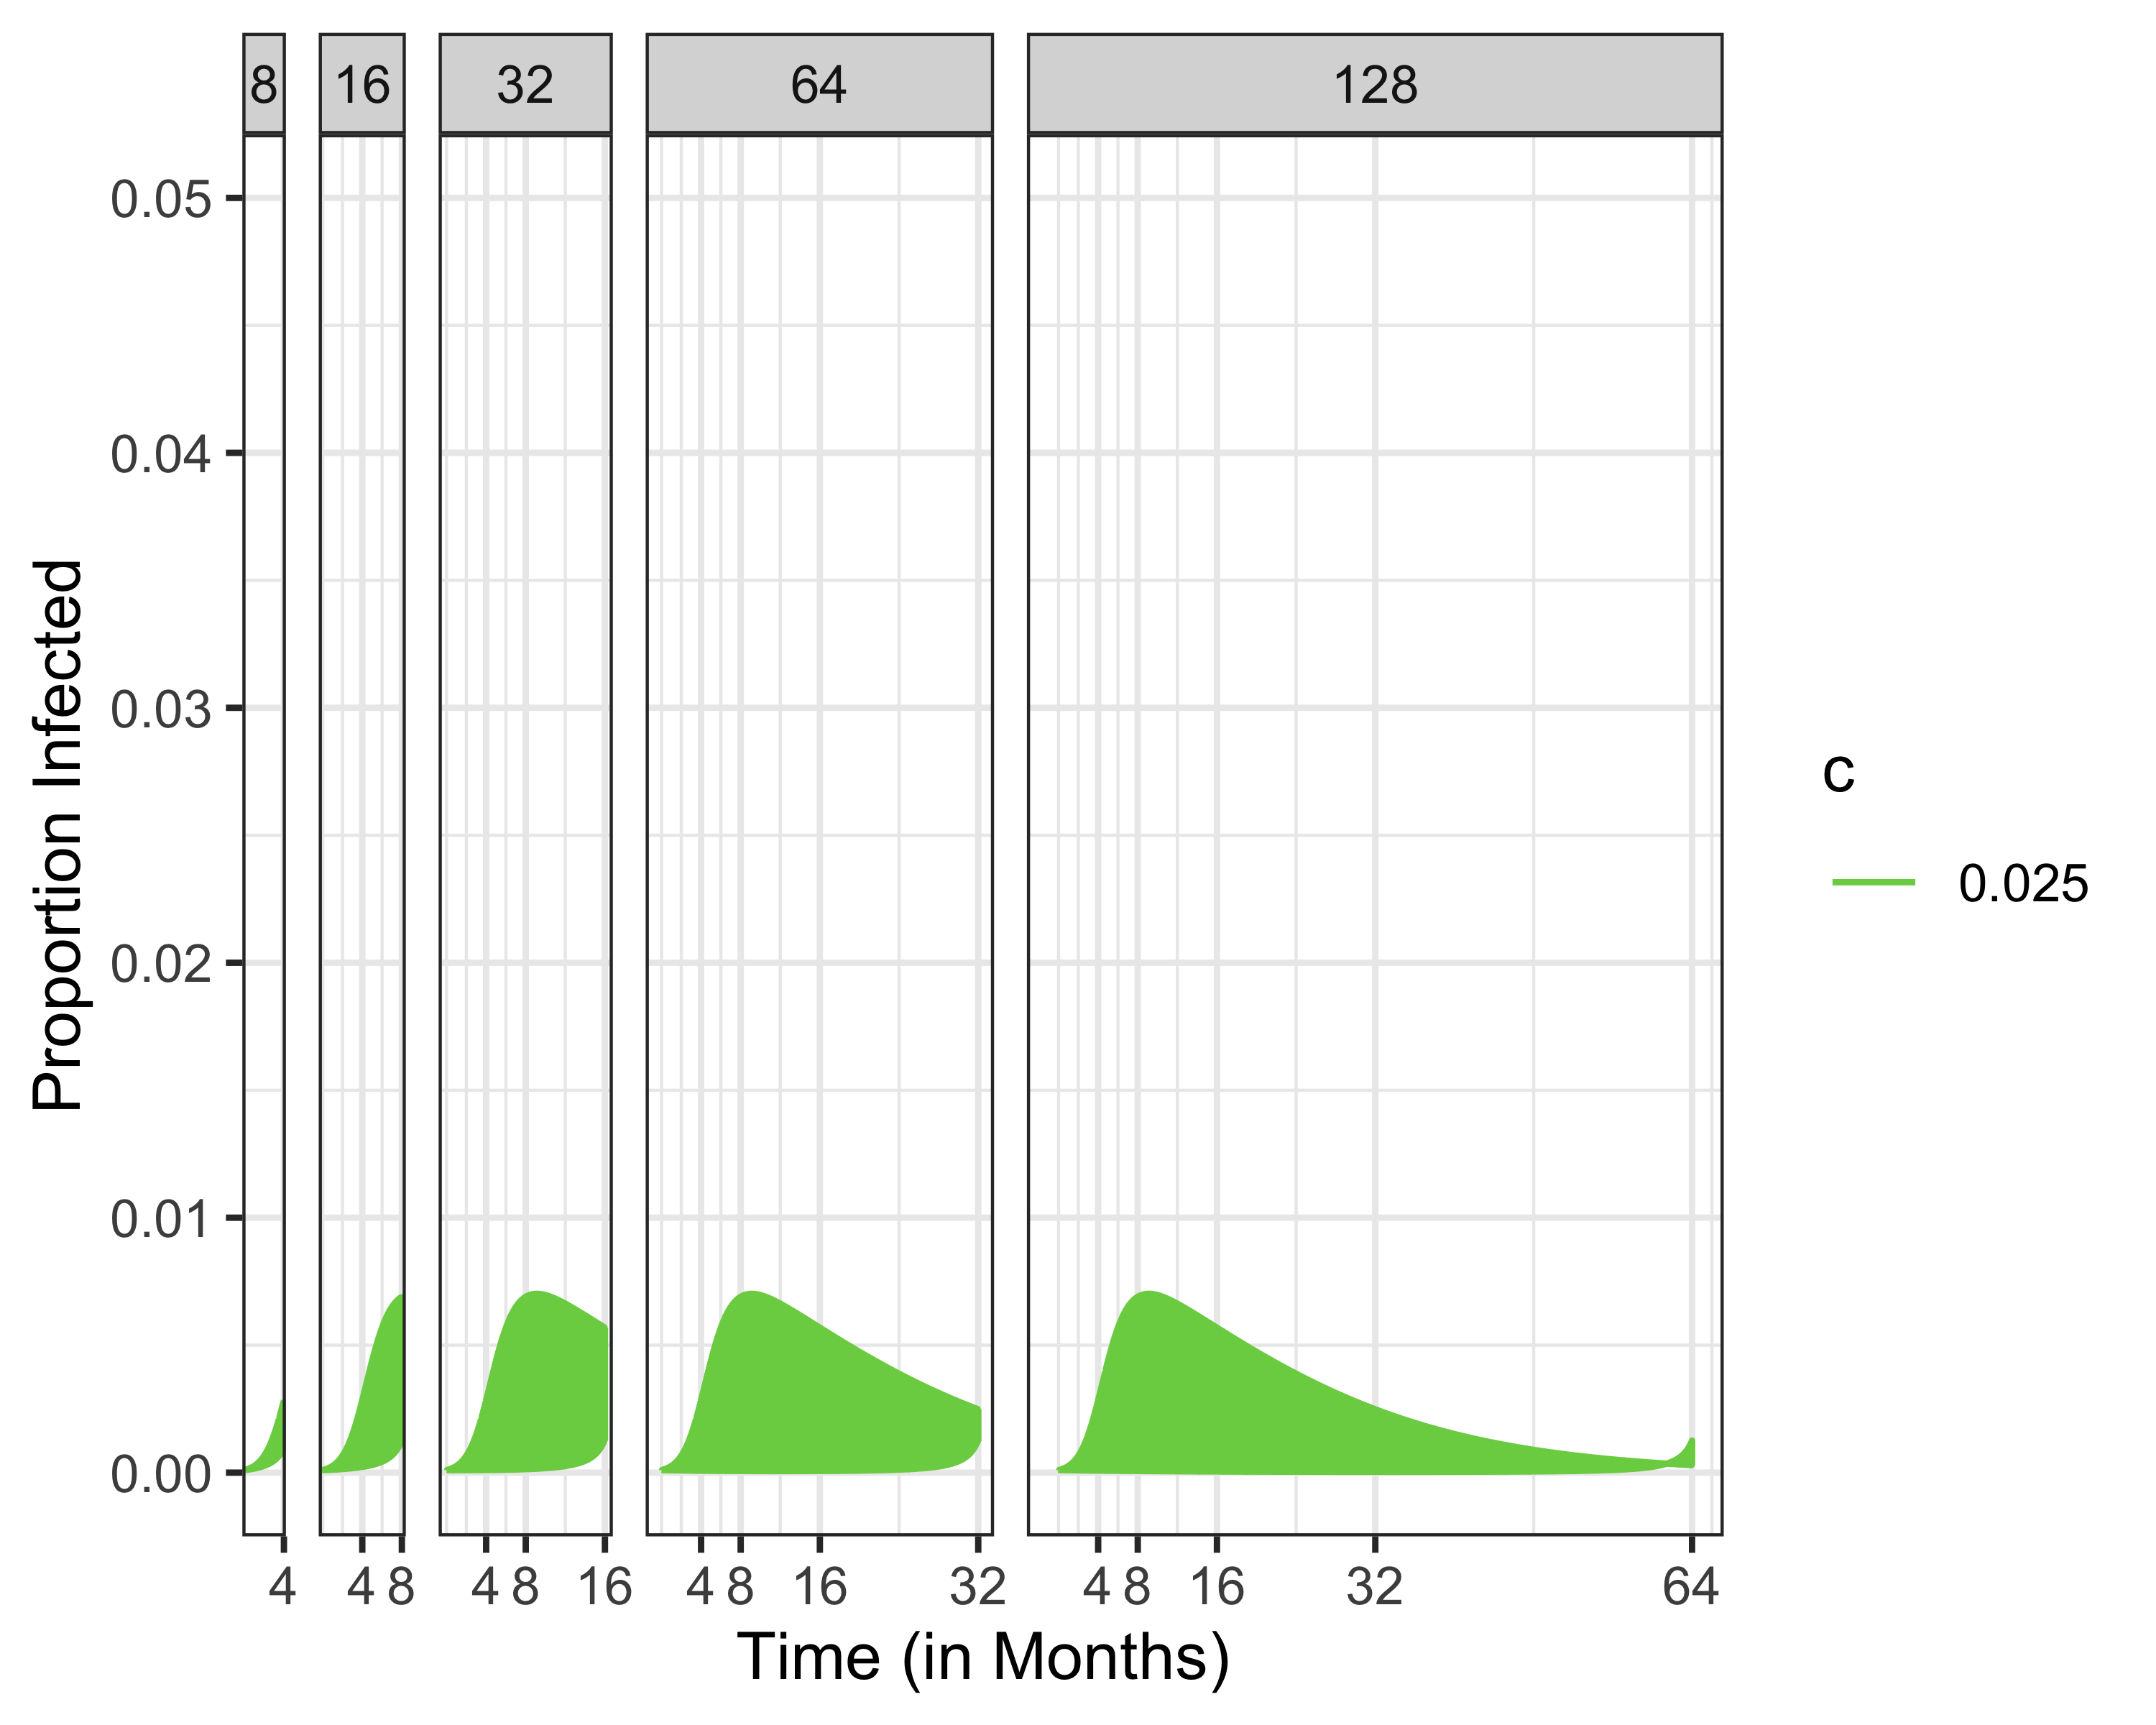
Infected, R0 = 1.5

Slide 25
# Infected, R0 = 1.5

Slide 26
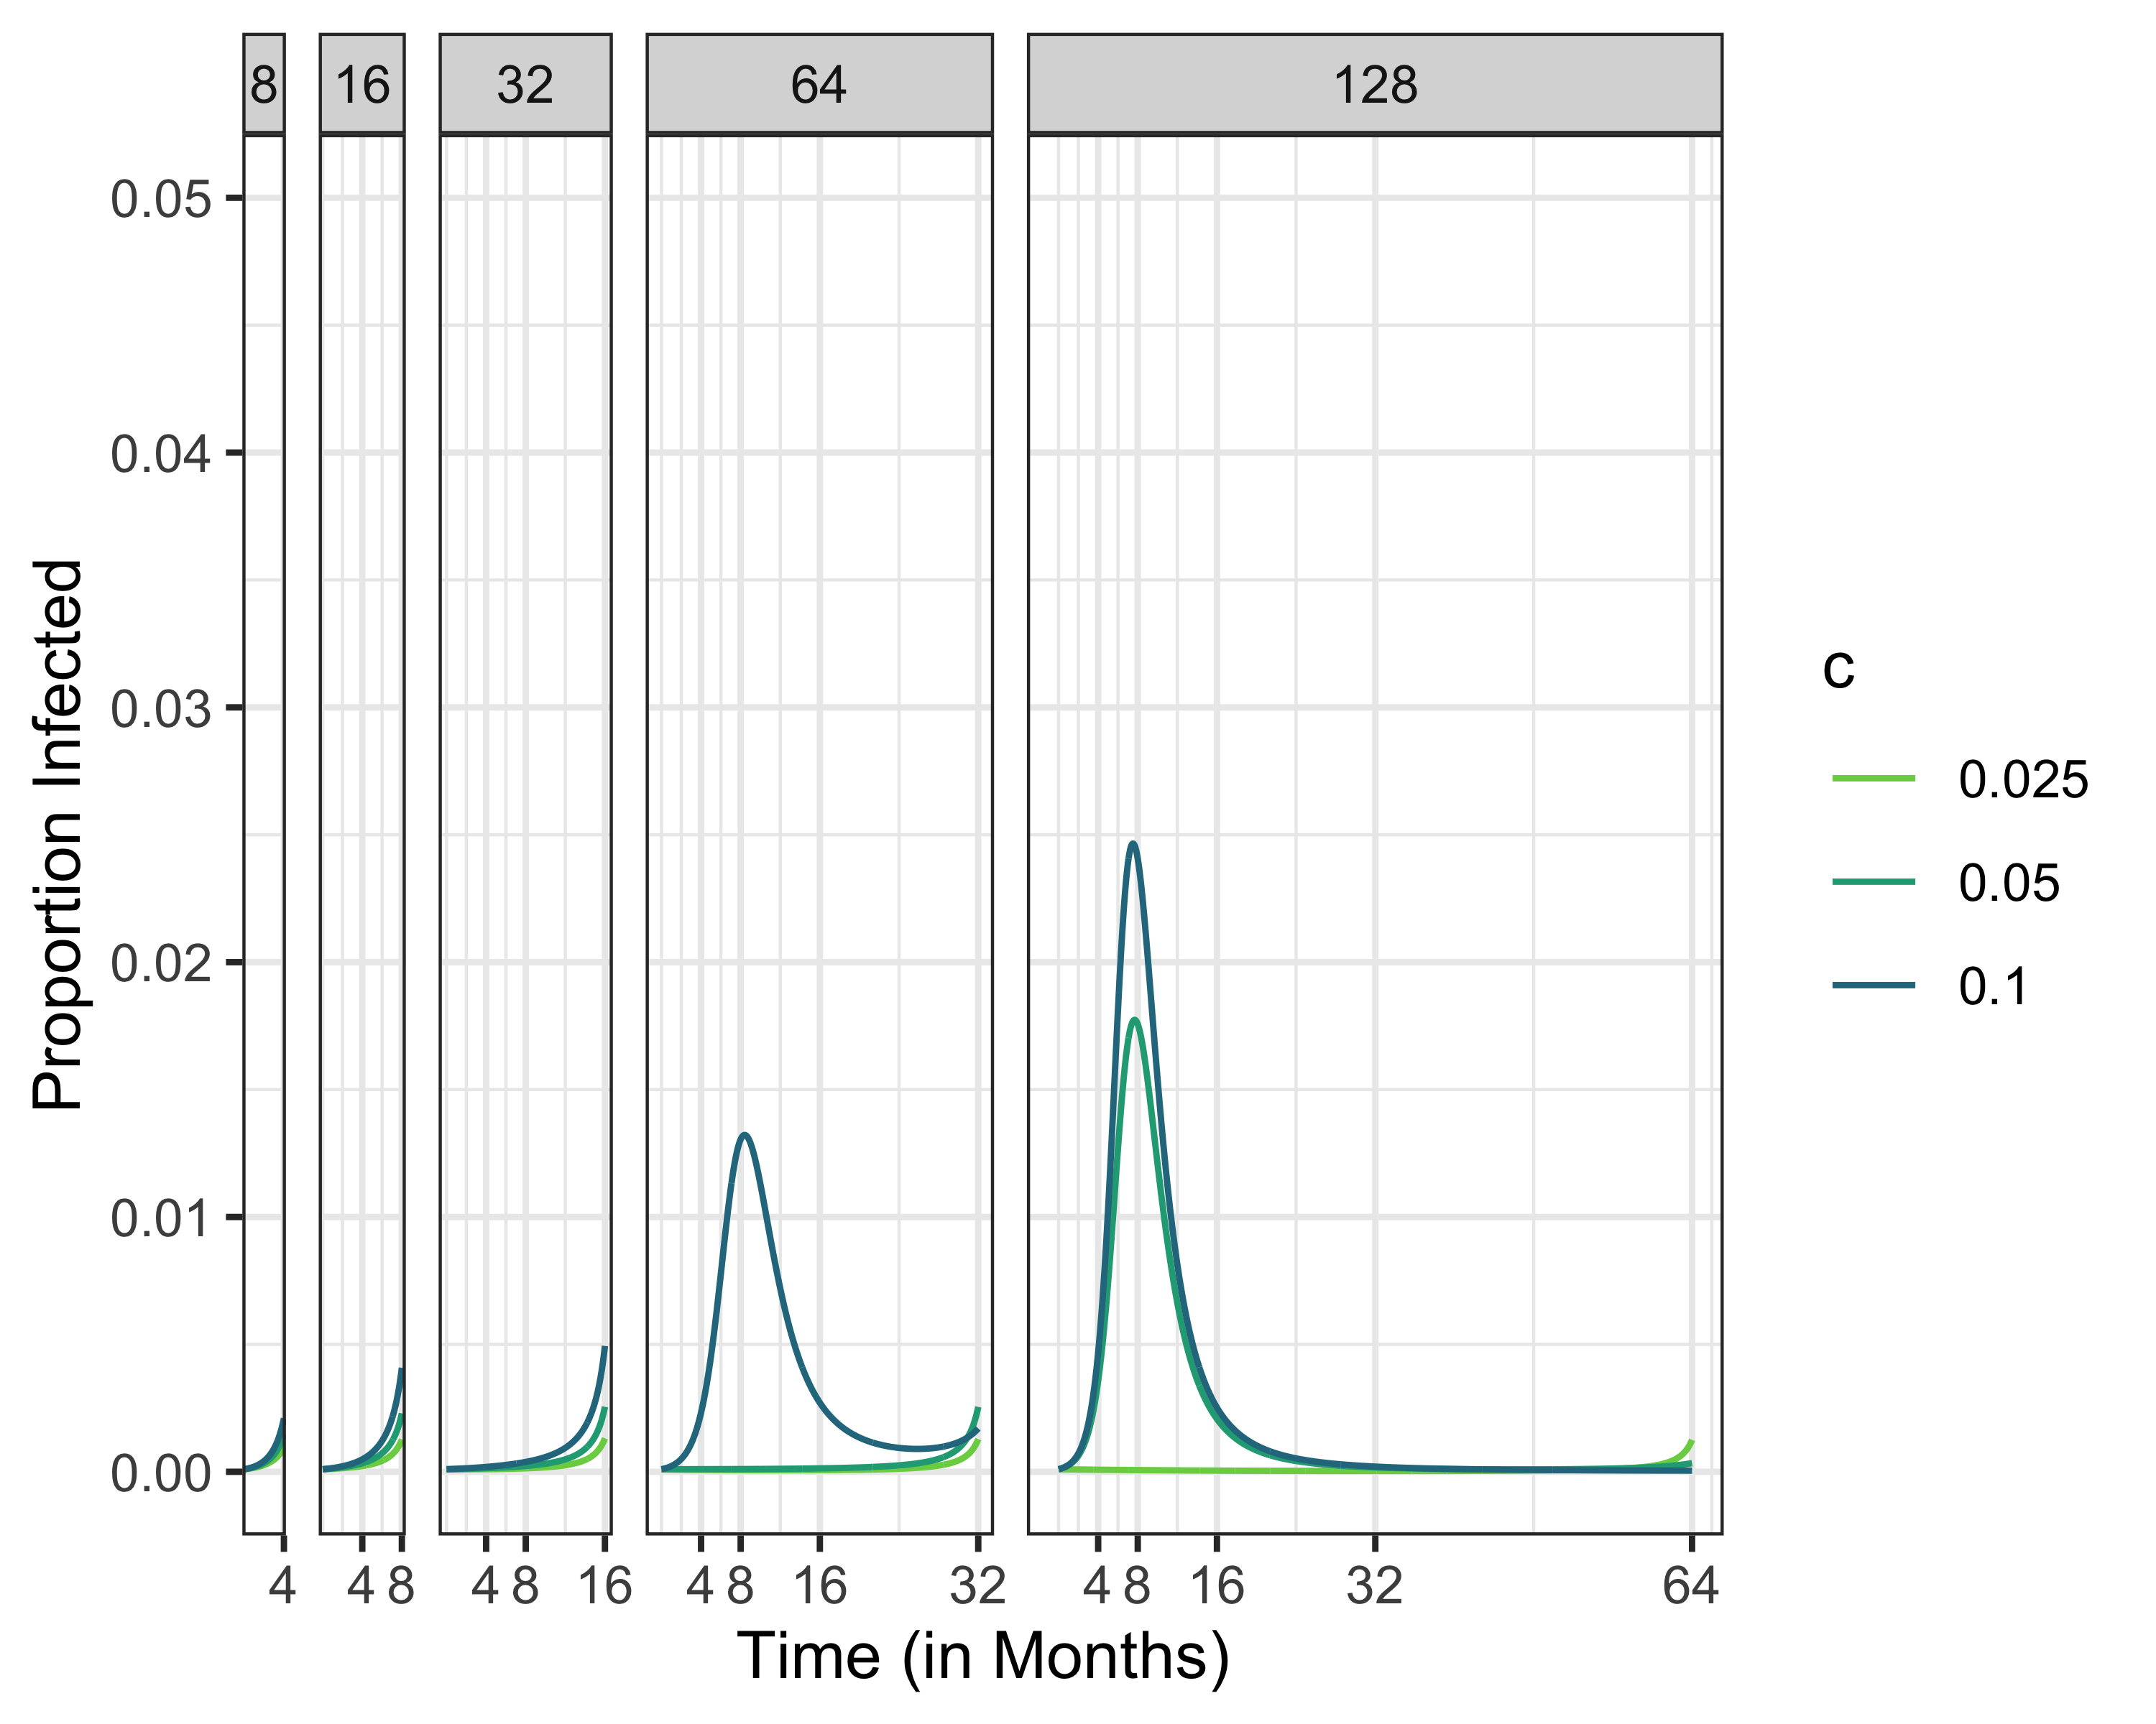
Infected, R0 = 1.5

Slide 27
# Infected, R0 = 1.5

Slide 28
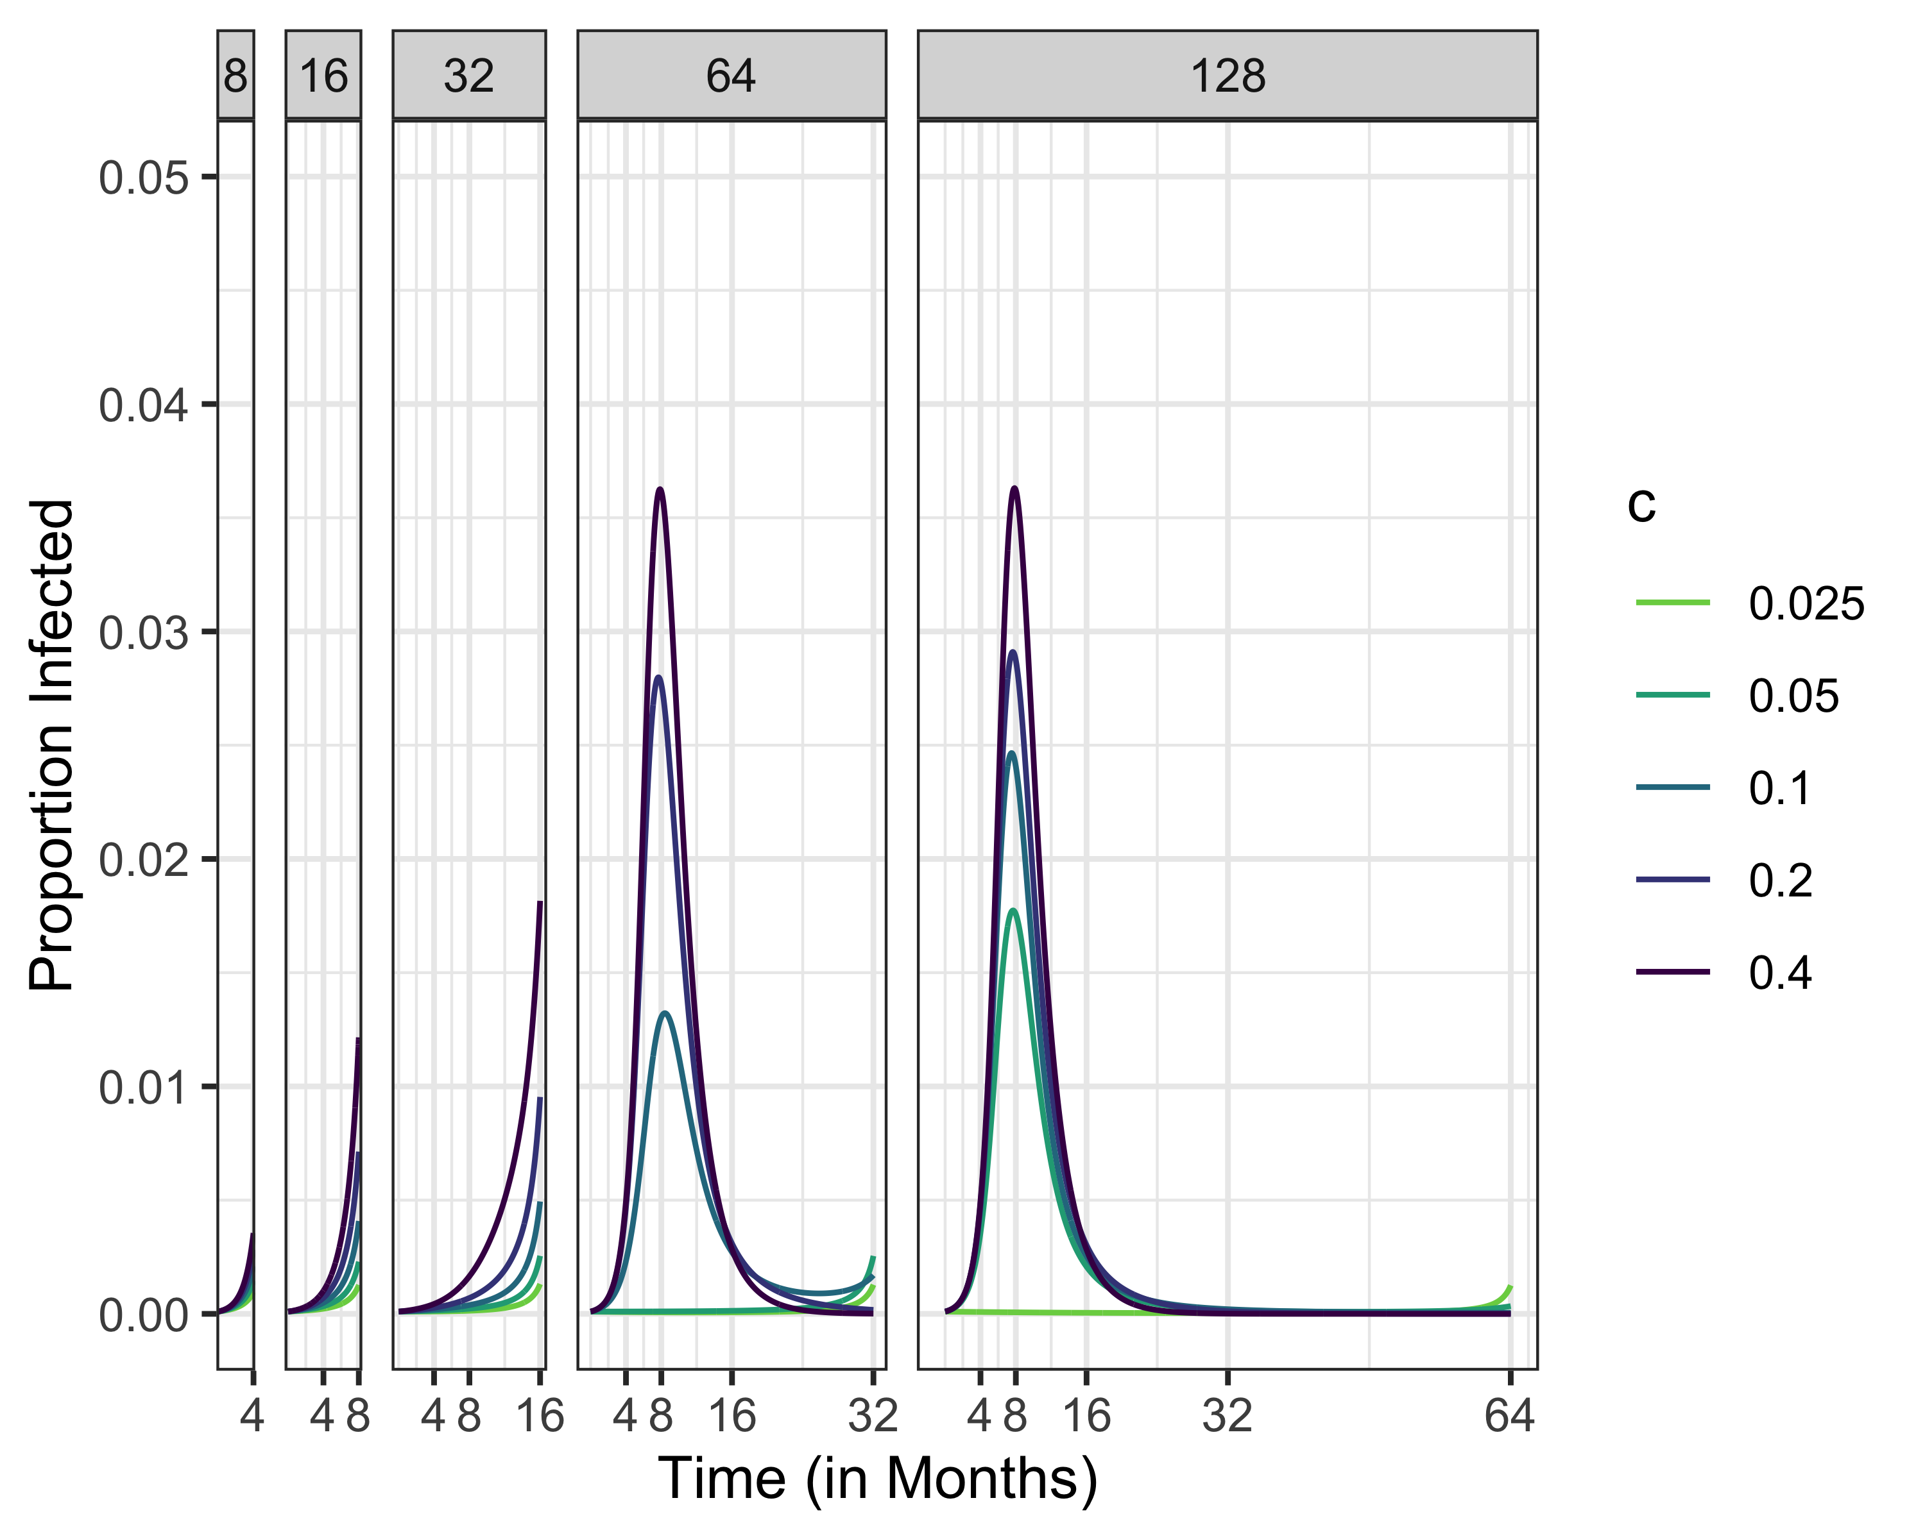
Infected, R0 = 1.5

Slide 29
# Infected, R0 = 2.5 # Infected, R0 = 5

Slide 30
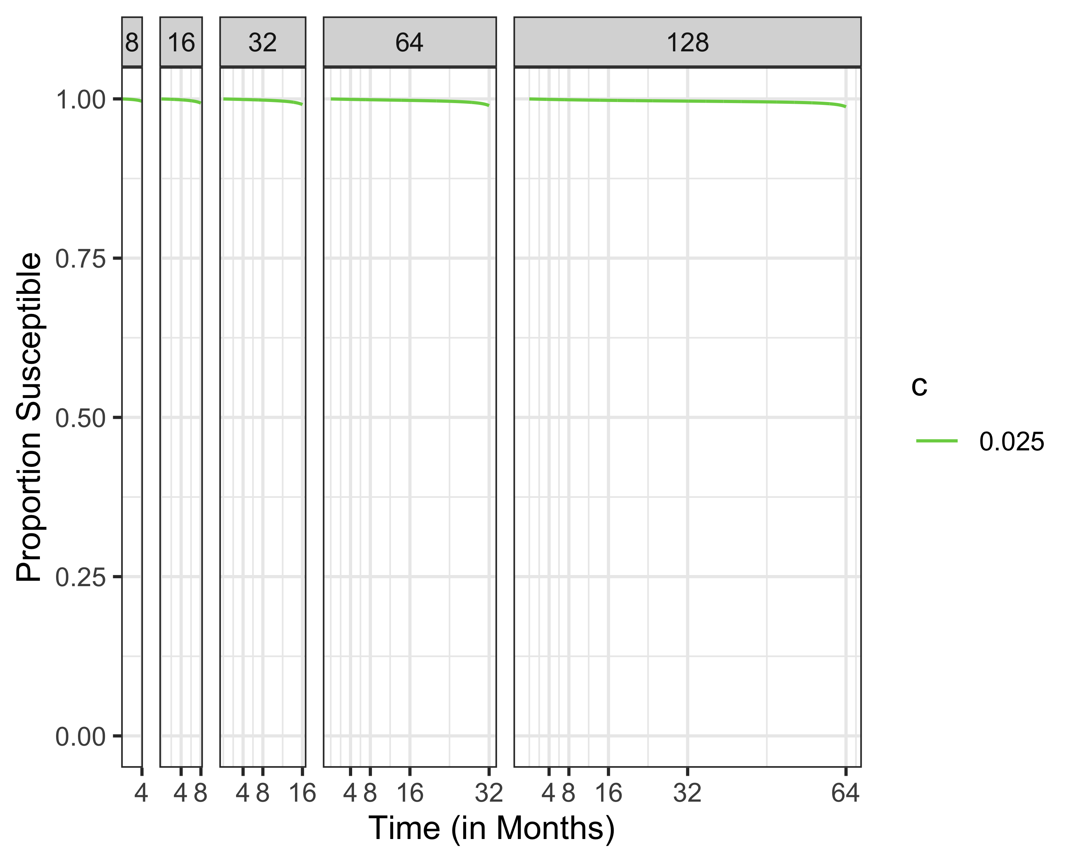
Susceptibles Different Time Horizons

Slide 31
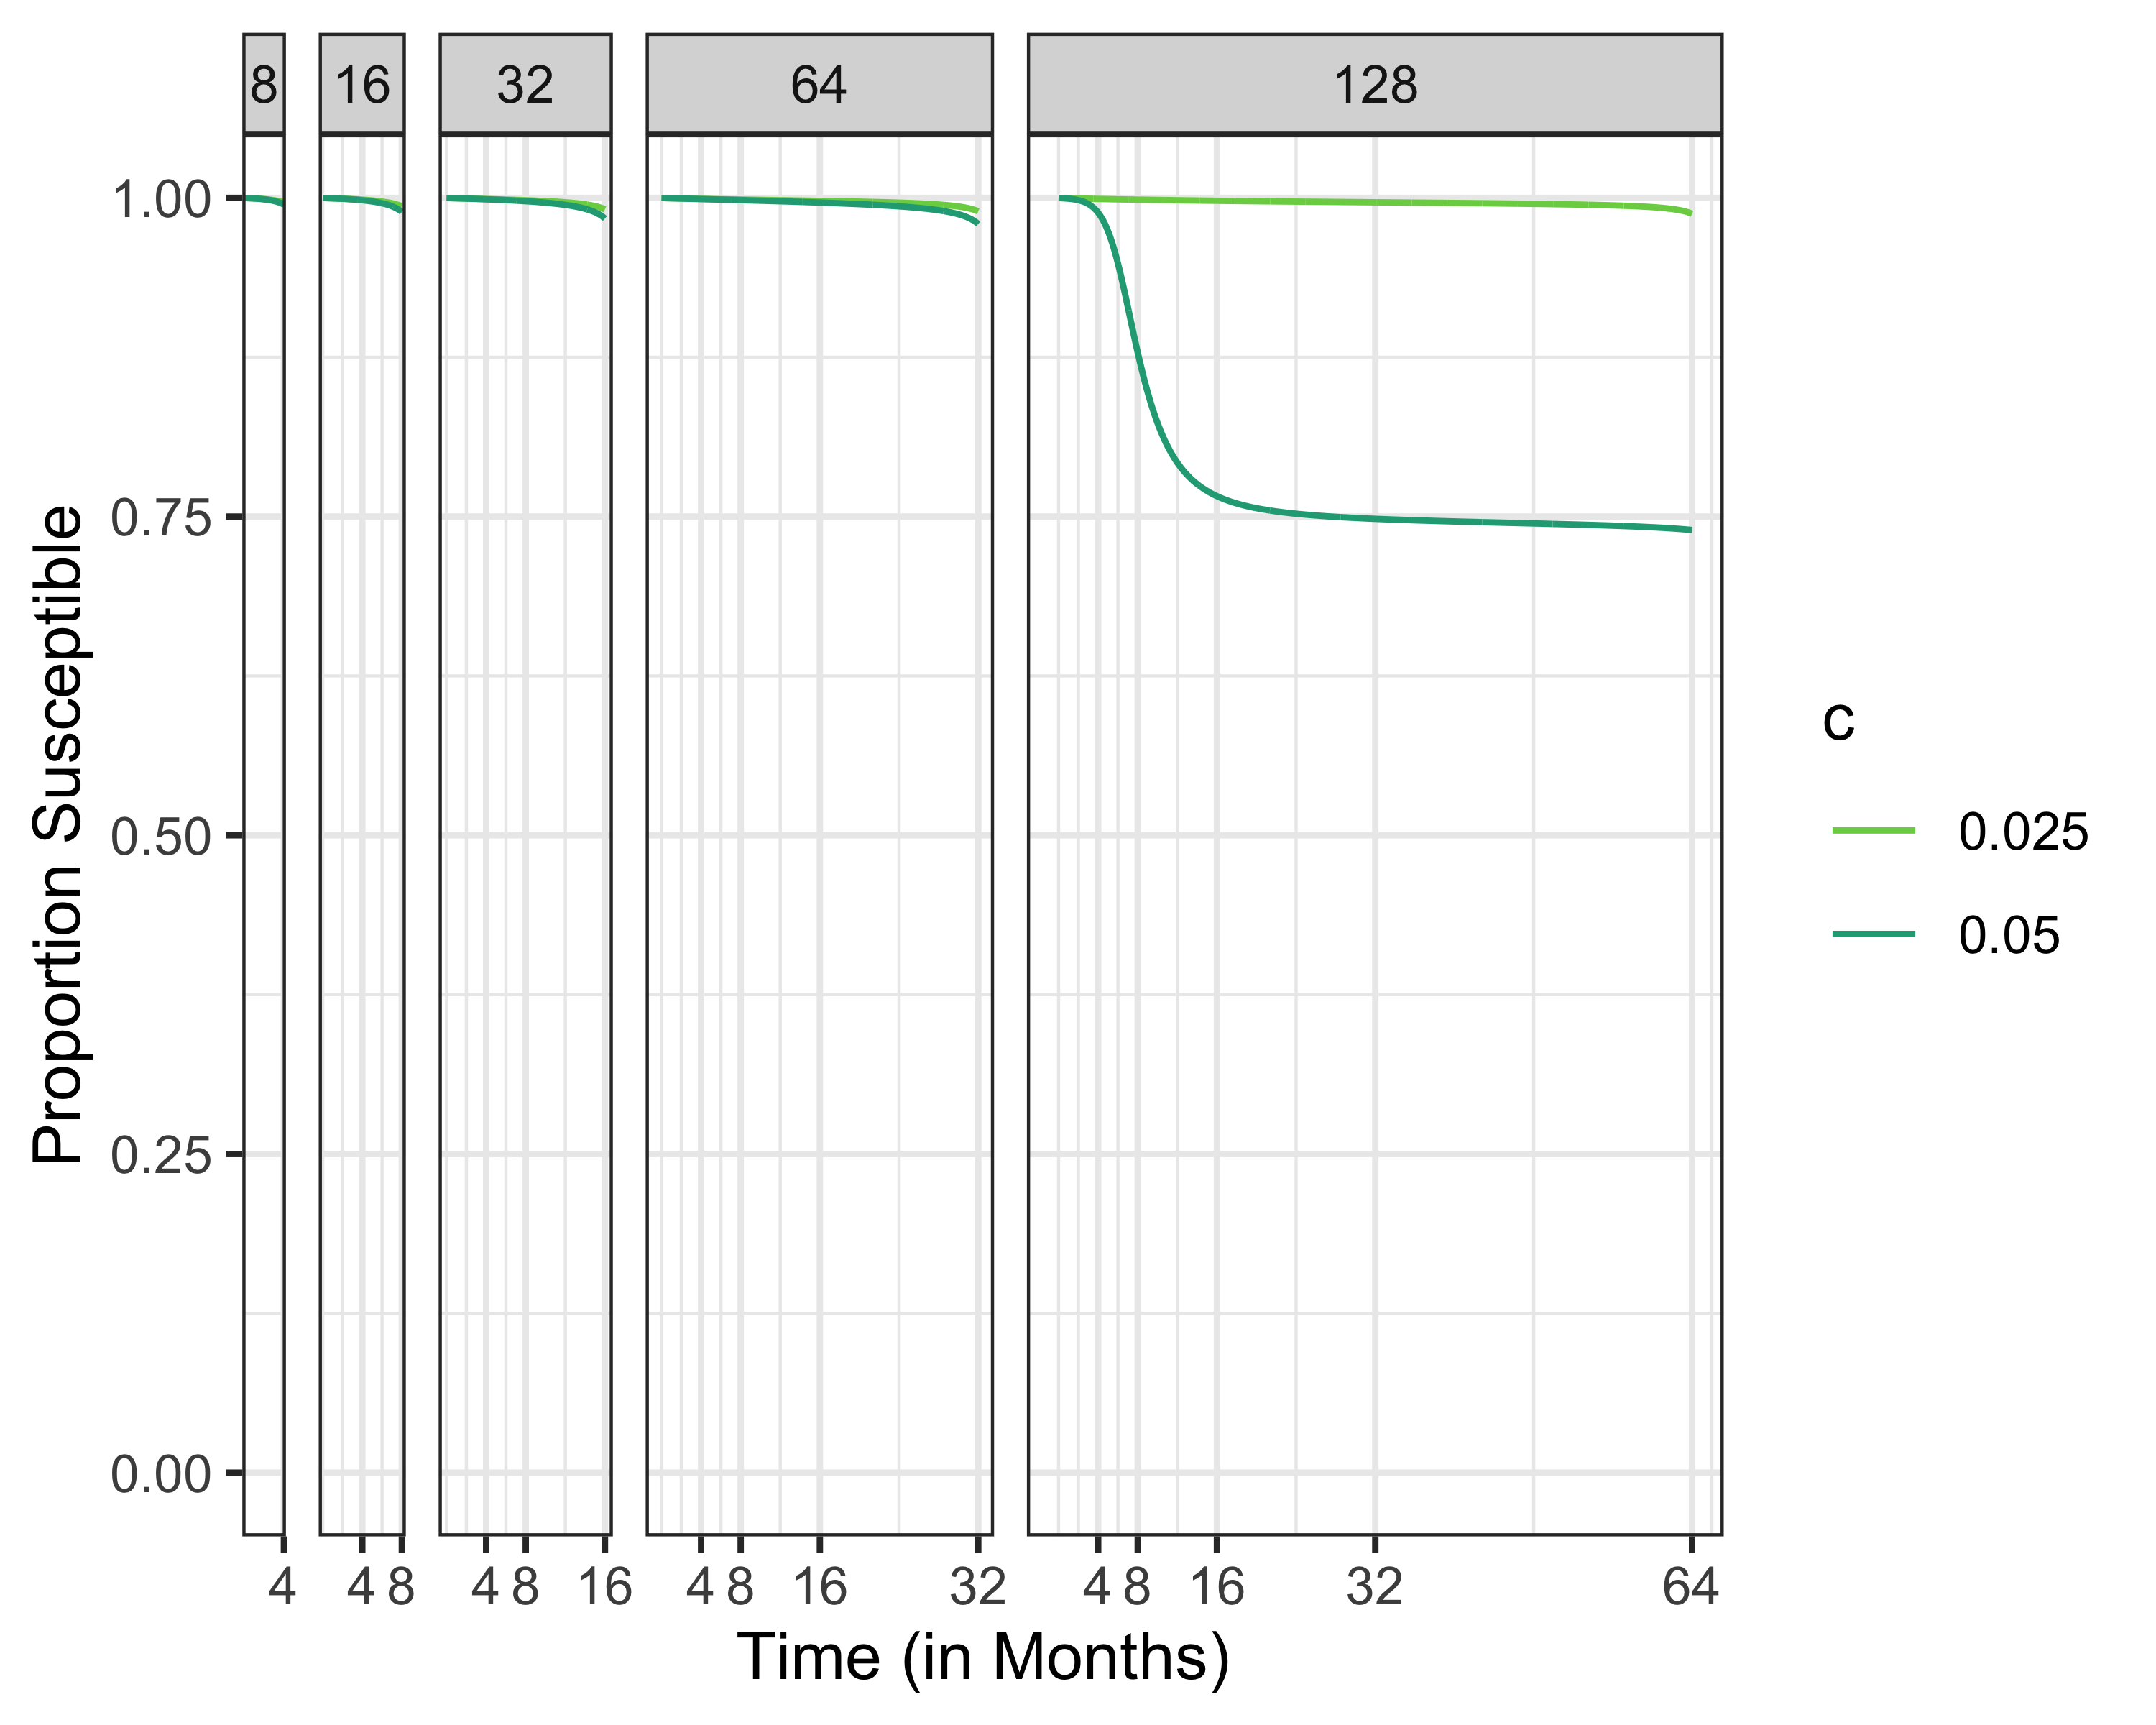
Susceptibles Different Time Horizons

Slide 32
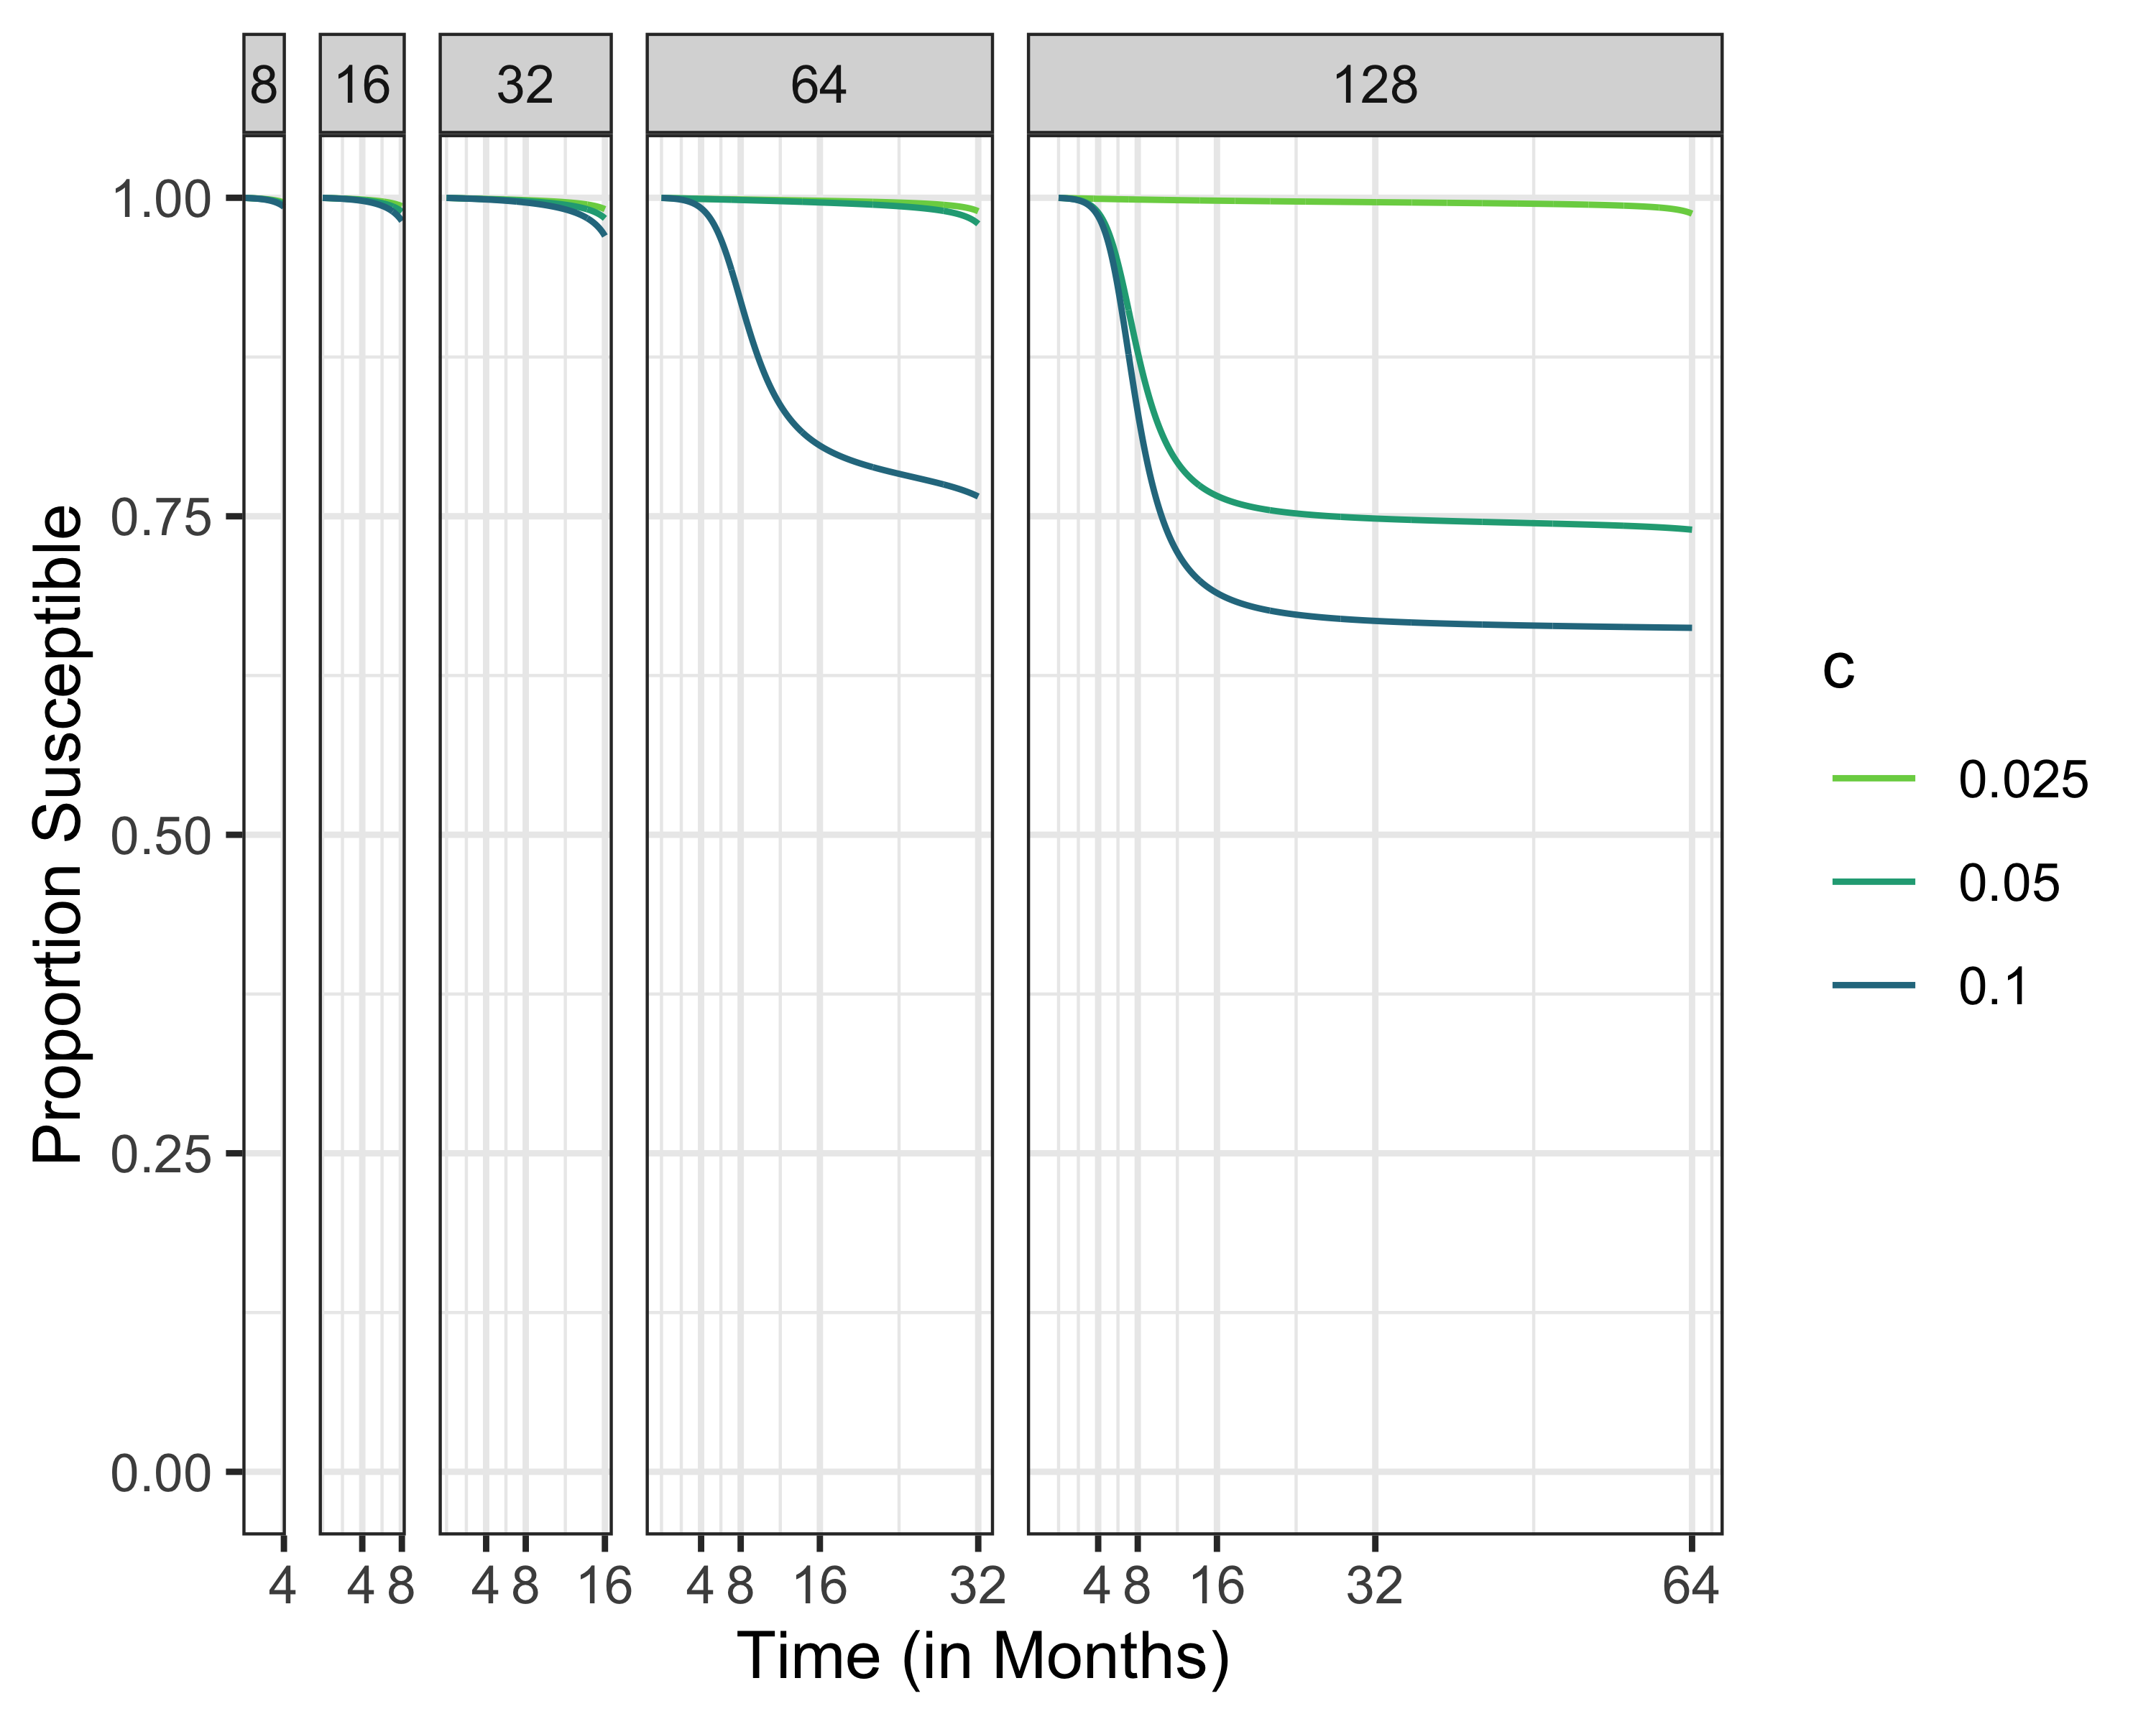
Susceptibles Different Time Horizons

Slide 33
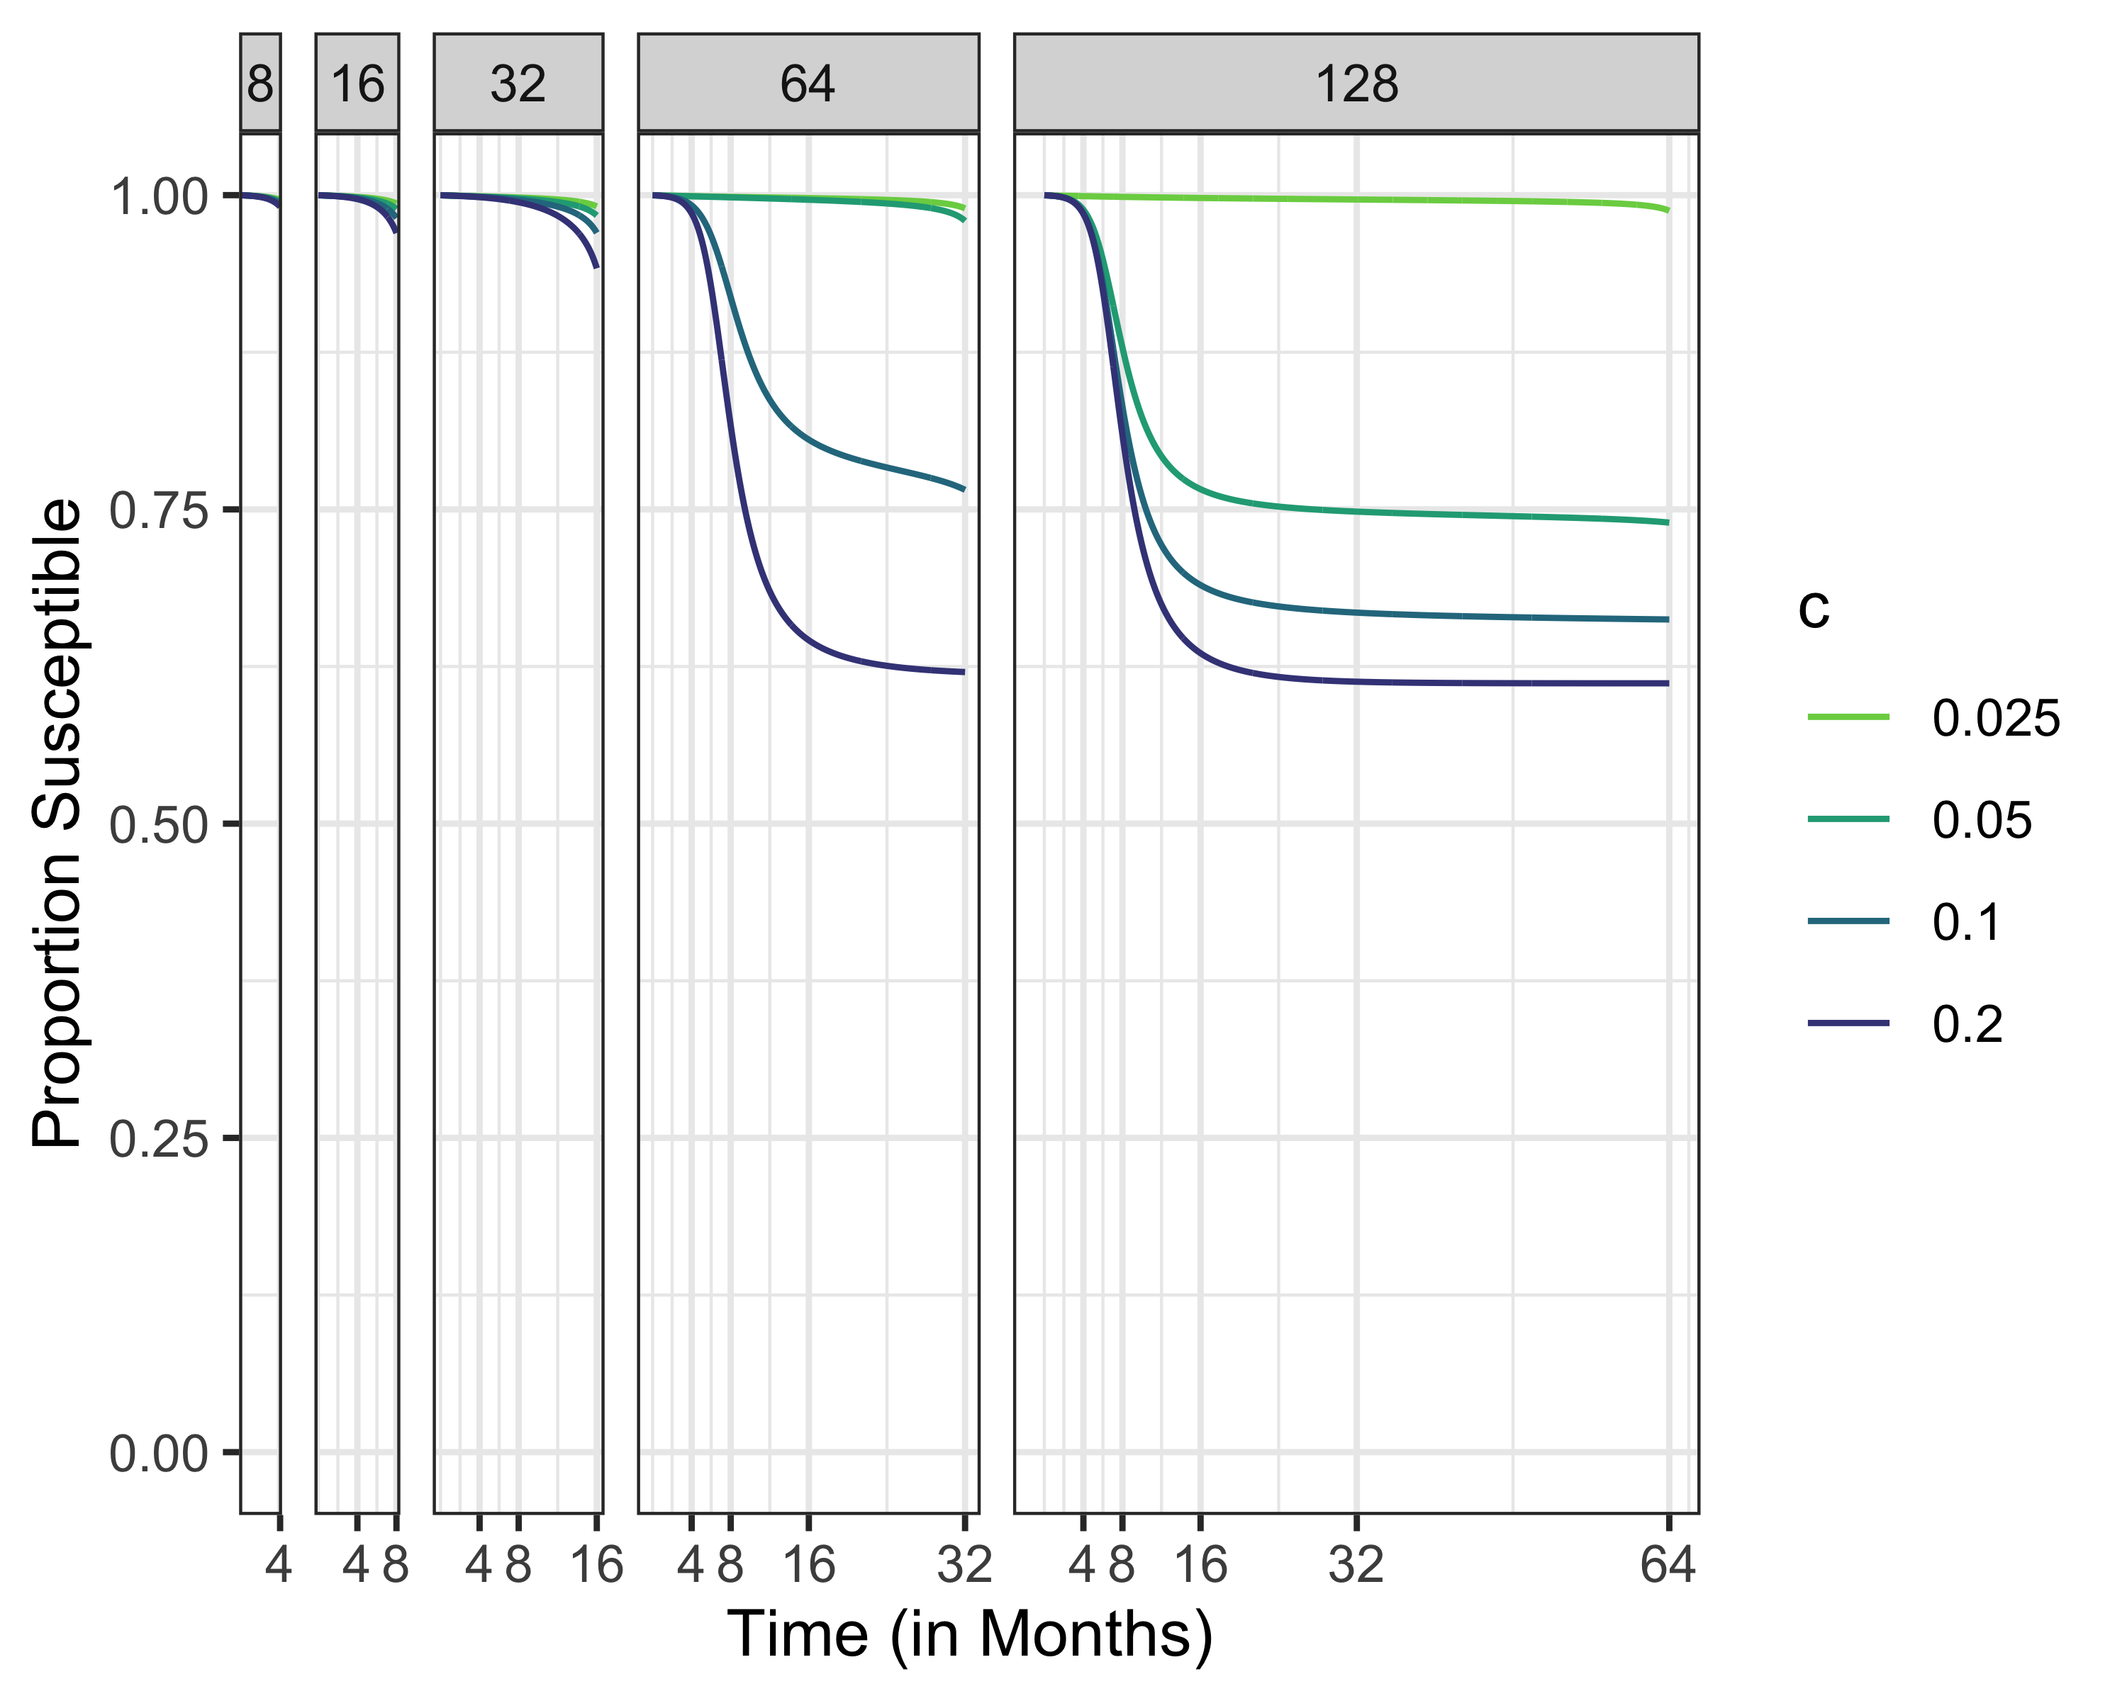
Susceptibles Different Time Horizons

Slide 34
Sinf1.5 <- multiroot.1D(f=f1.5,start = .5,nspec= 1)[["root"]] Sinf2.5 <- multiroot.1D(f=f2.5,start = .5,nspec= 1)[["root"]] Sinf5 <- multiroot.1D(f=f5,start = .5,nspec= 1)[["root"]] S1.5max <- 1/1.5 S2.5max <- 1/2.5 S5max <- 1/5

Slide 35
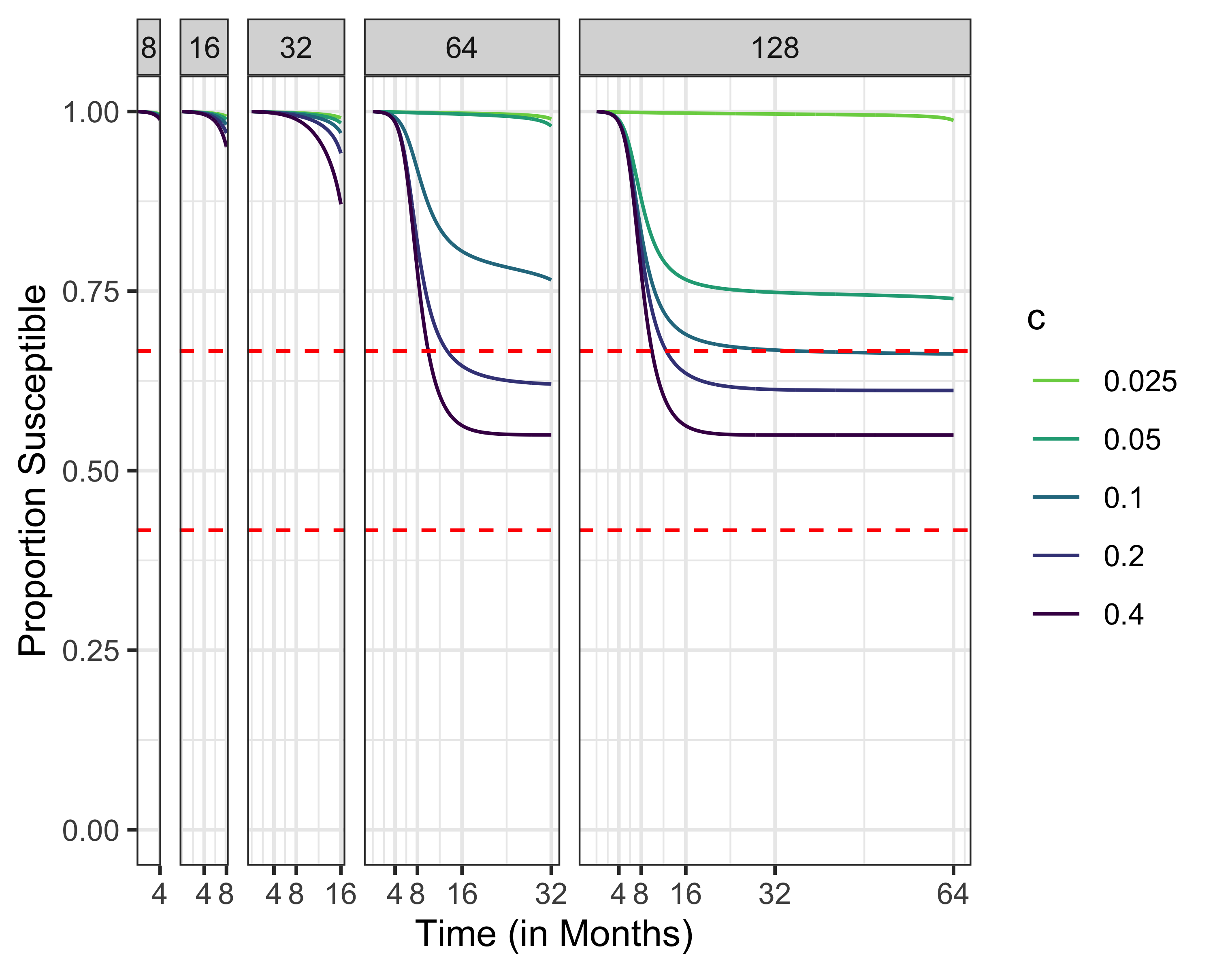
Susceptibles, R0 = 1.5

Slide 36
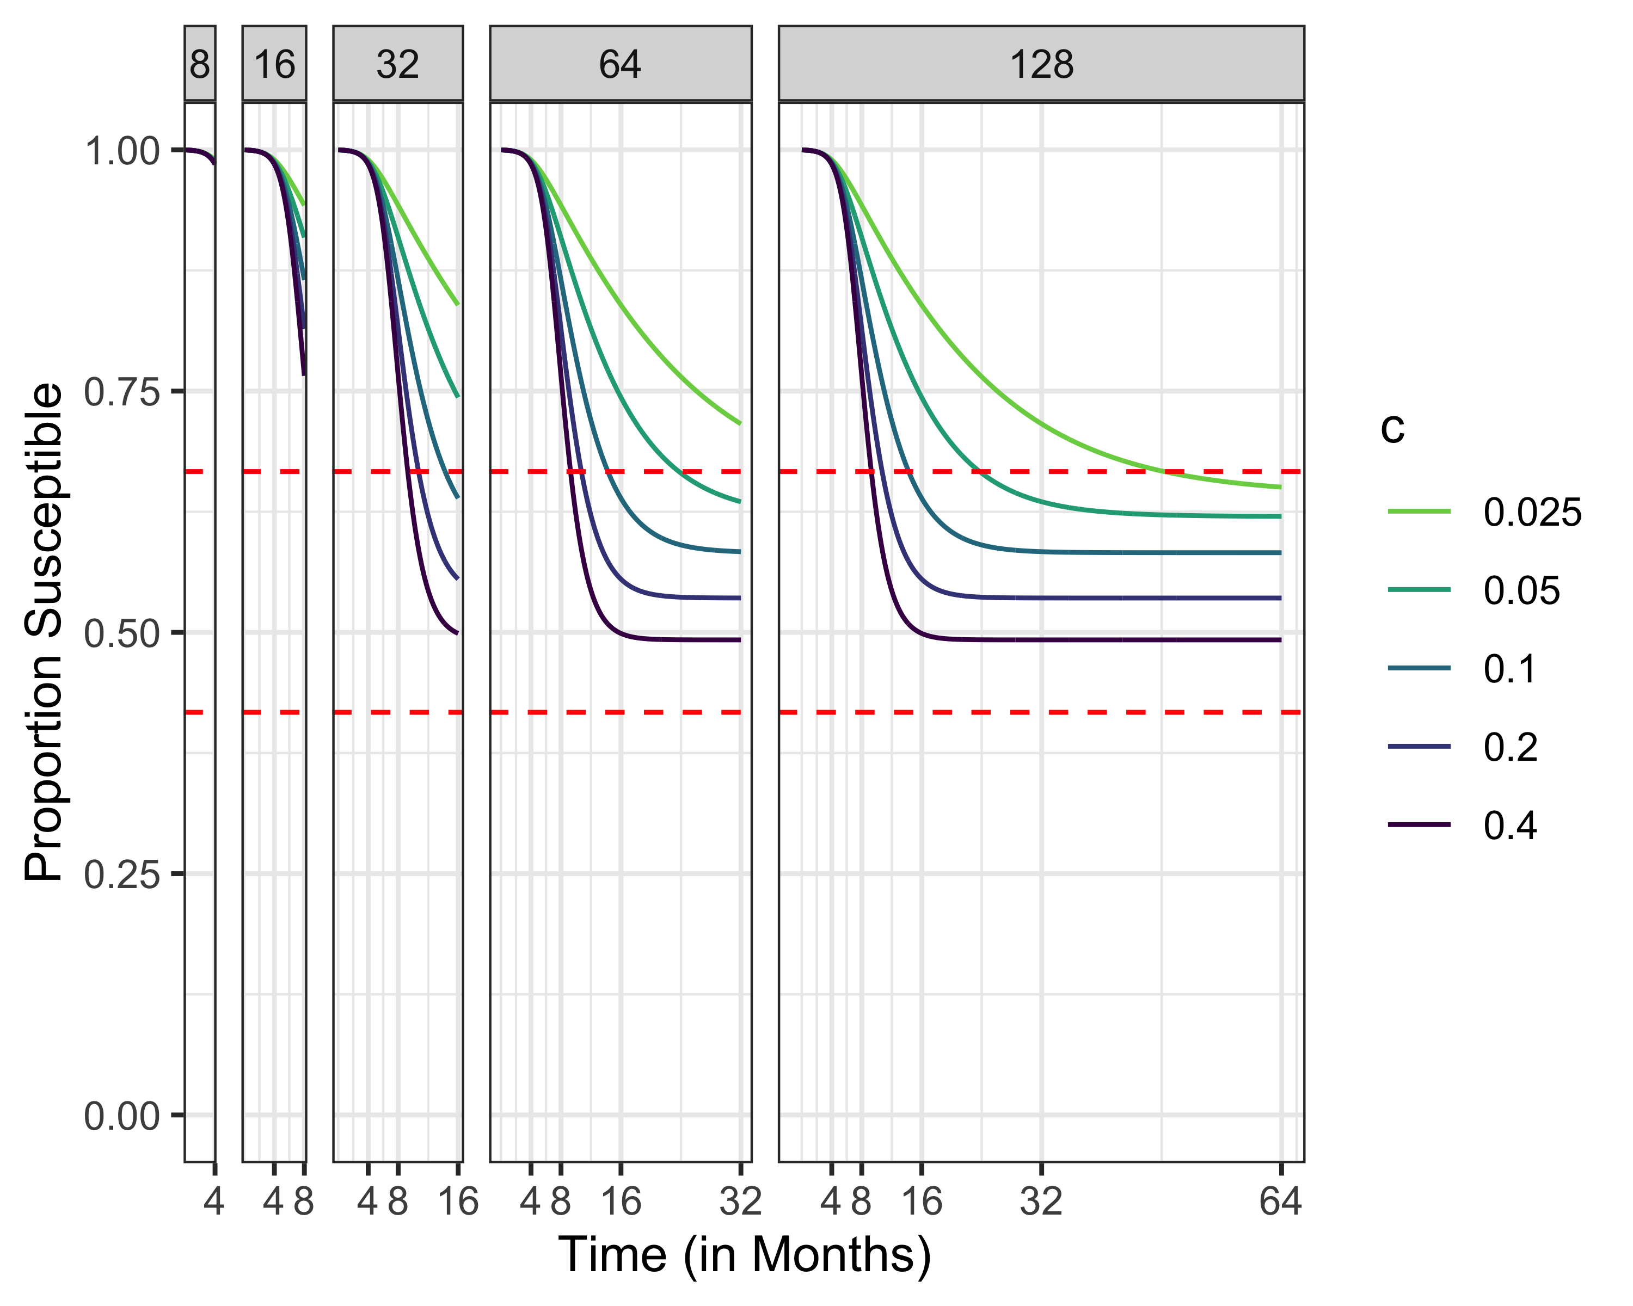

Slide 37
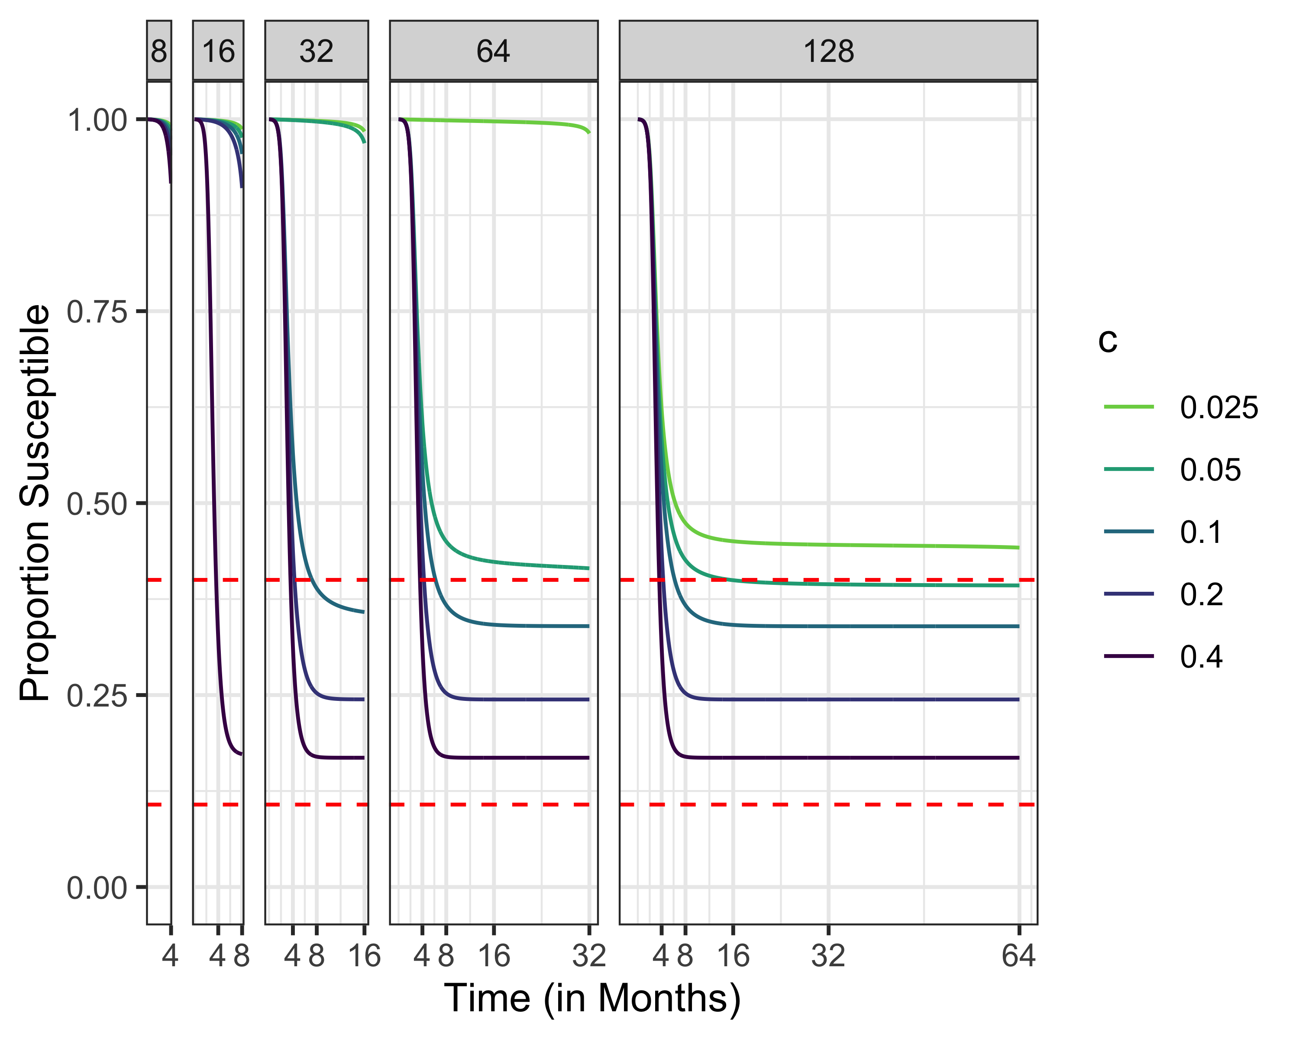
Susceptibles, R0 = 2.5

Slide 38
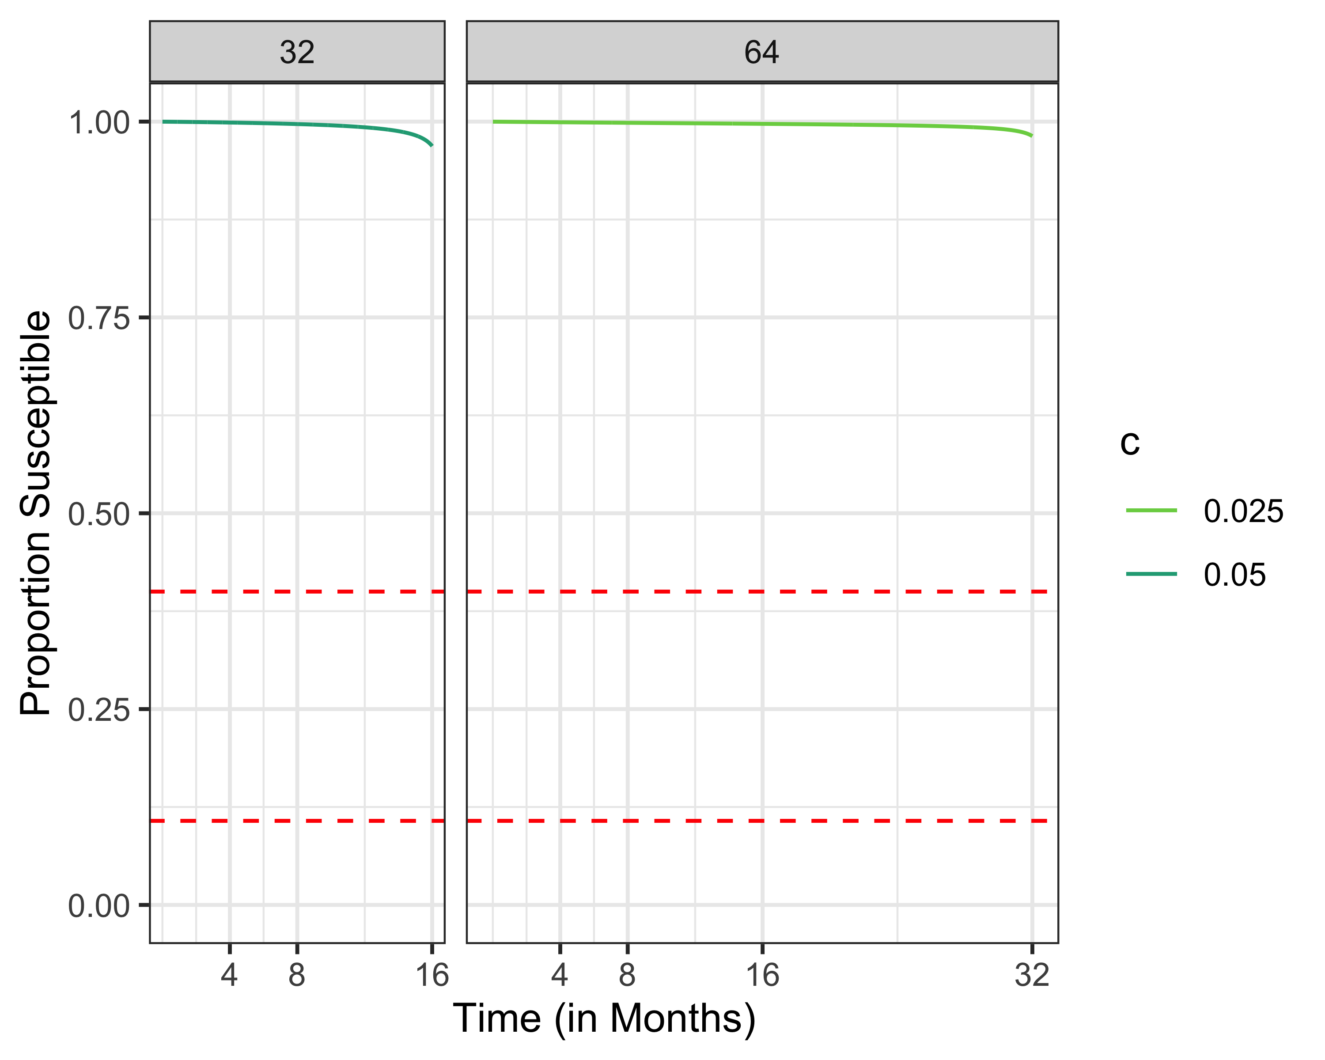
Susceptibles, R0 = 2.5

Slide 39
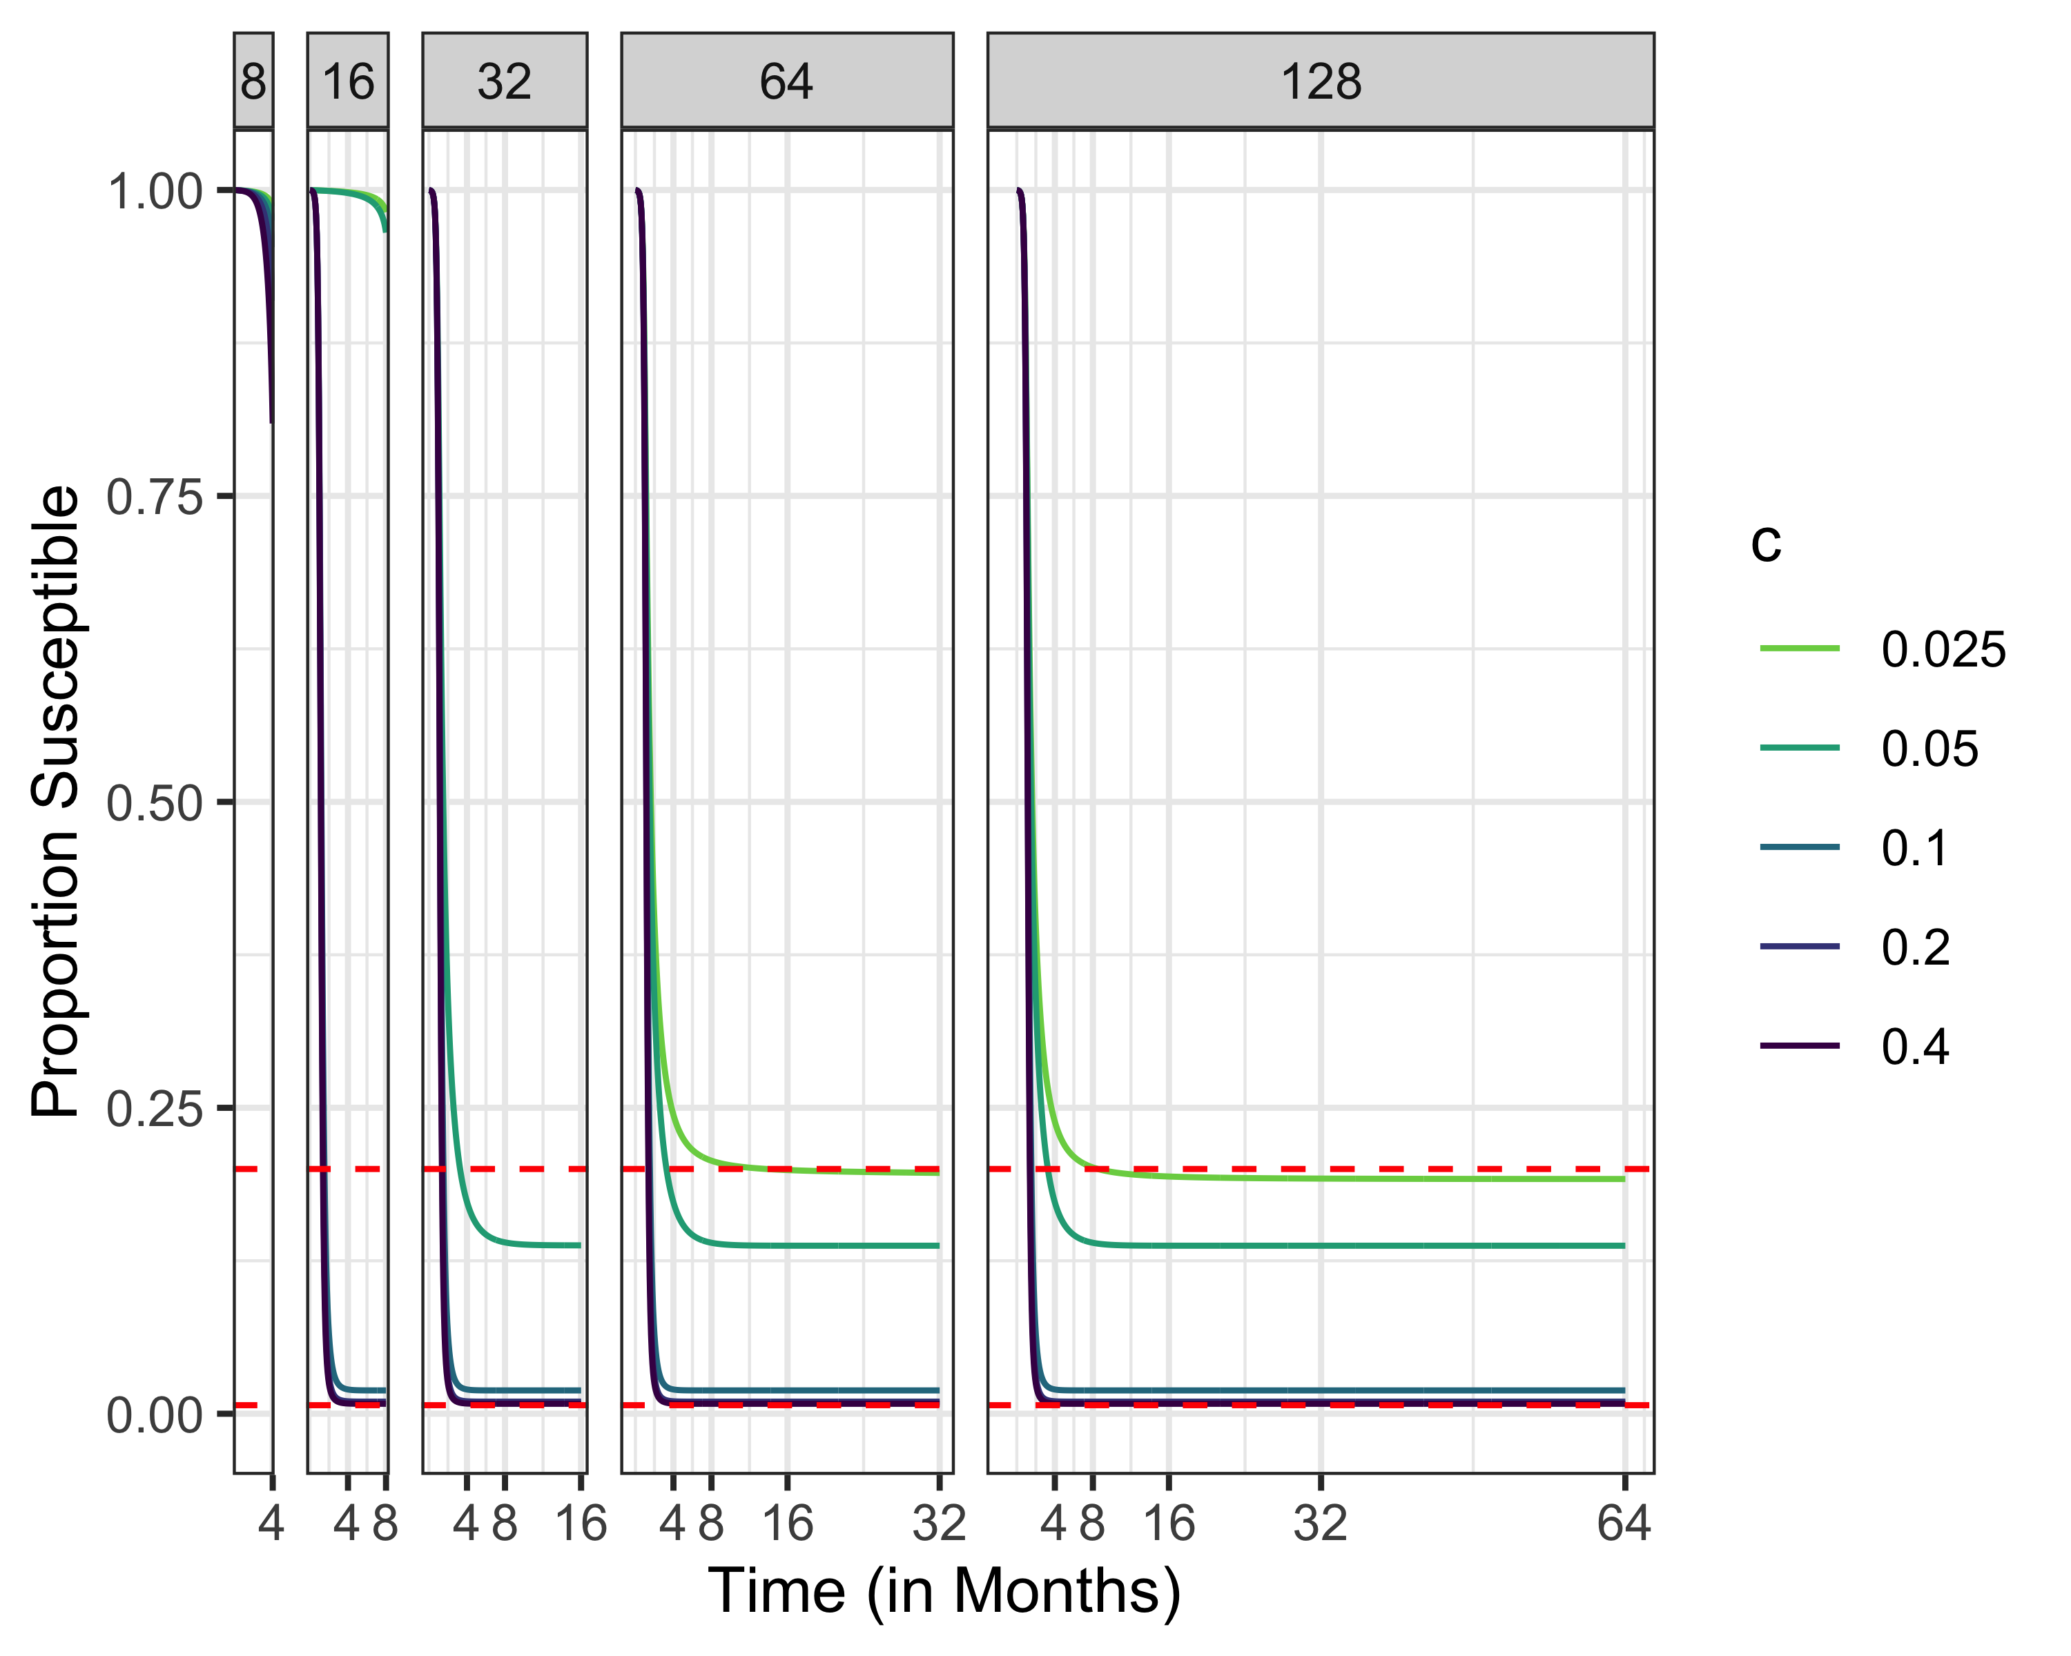
Susceptibles, R0 = 5

